Slide 1
Parallel programming with standard Fortran and C++
Jongsoo Kim, KASI
Presentation at a runningLab meeting
2023-06-21

Slide 2
References
https://developer.nvidia.com/blog/accelerating-standard-c-with-gpus-using-stdpar/
https://developer.nvidia.com/blog/accelerating-fortran-do-concurrent-with-gpus-and-the-nvidia-hpc-sdk/
https://www.nvidia.com/en-us/on-demand/session/gtcspring23-S51074/?ncid=em-even-124008-vt33

Slide 3
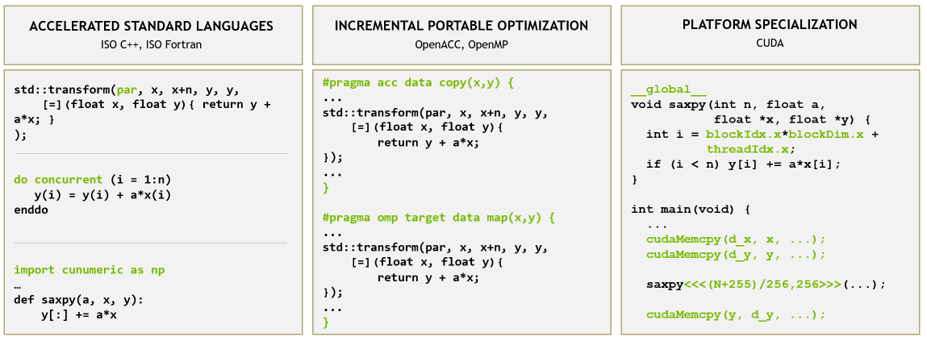
Three different programming approaches

Slide 4
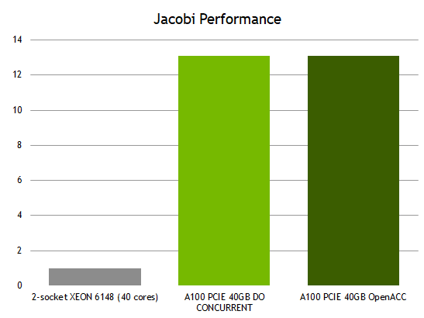
https://developer.nvidia.com/blog/accelerating-fortran-do-concurrent-with-gpus-and-the-nvidia-hpc-sdk/

Slide 5
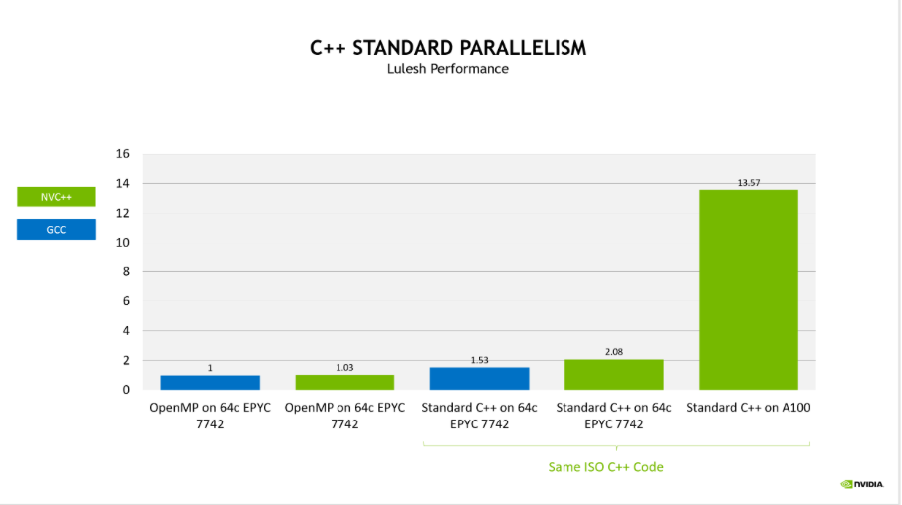

Slide 6
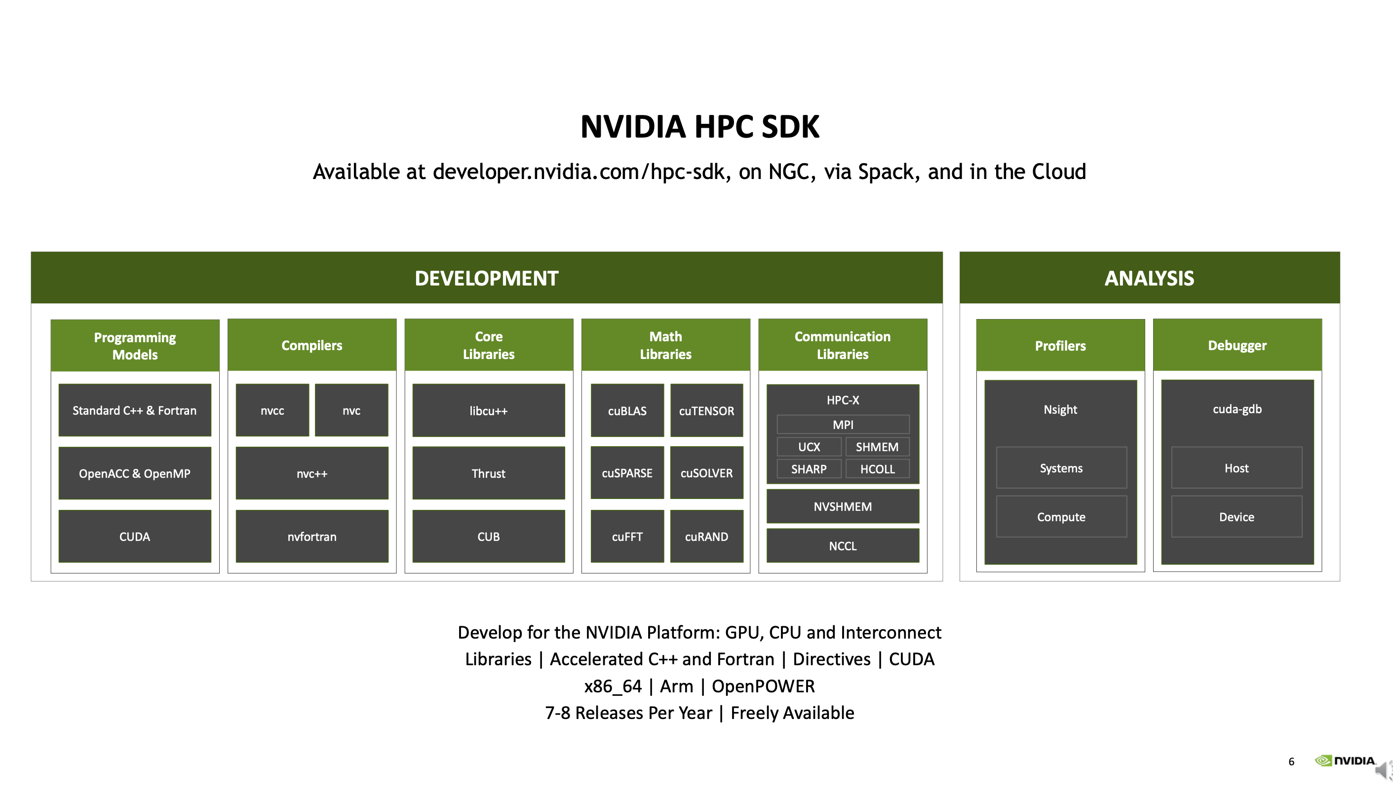

Slide 7
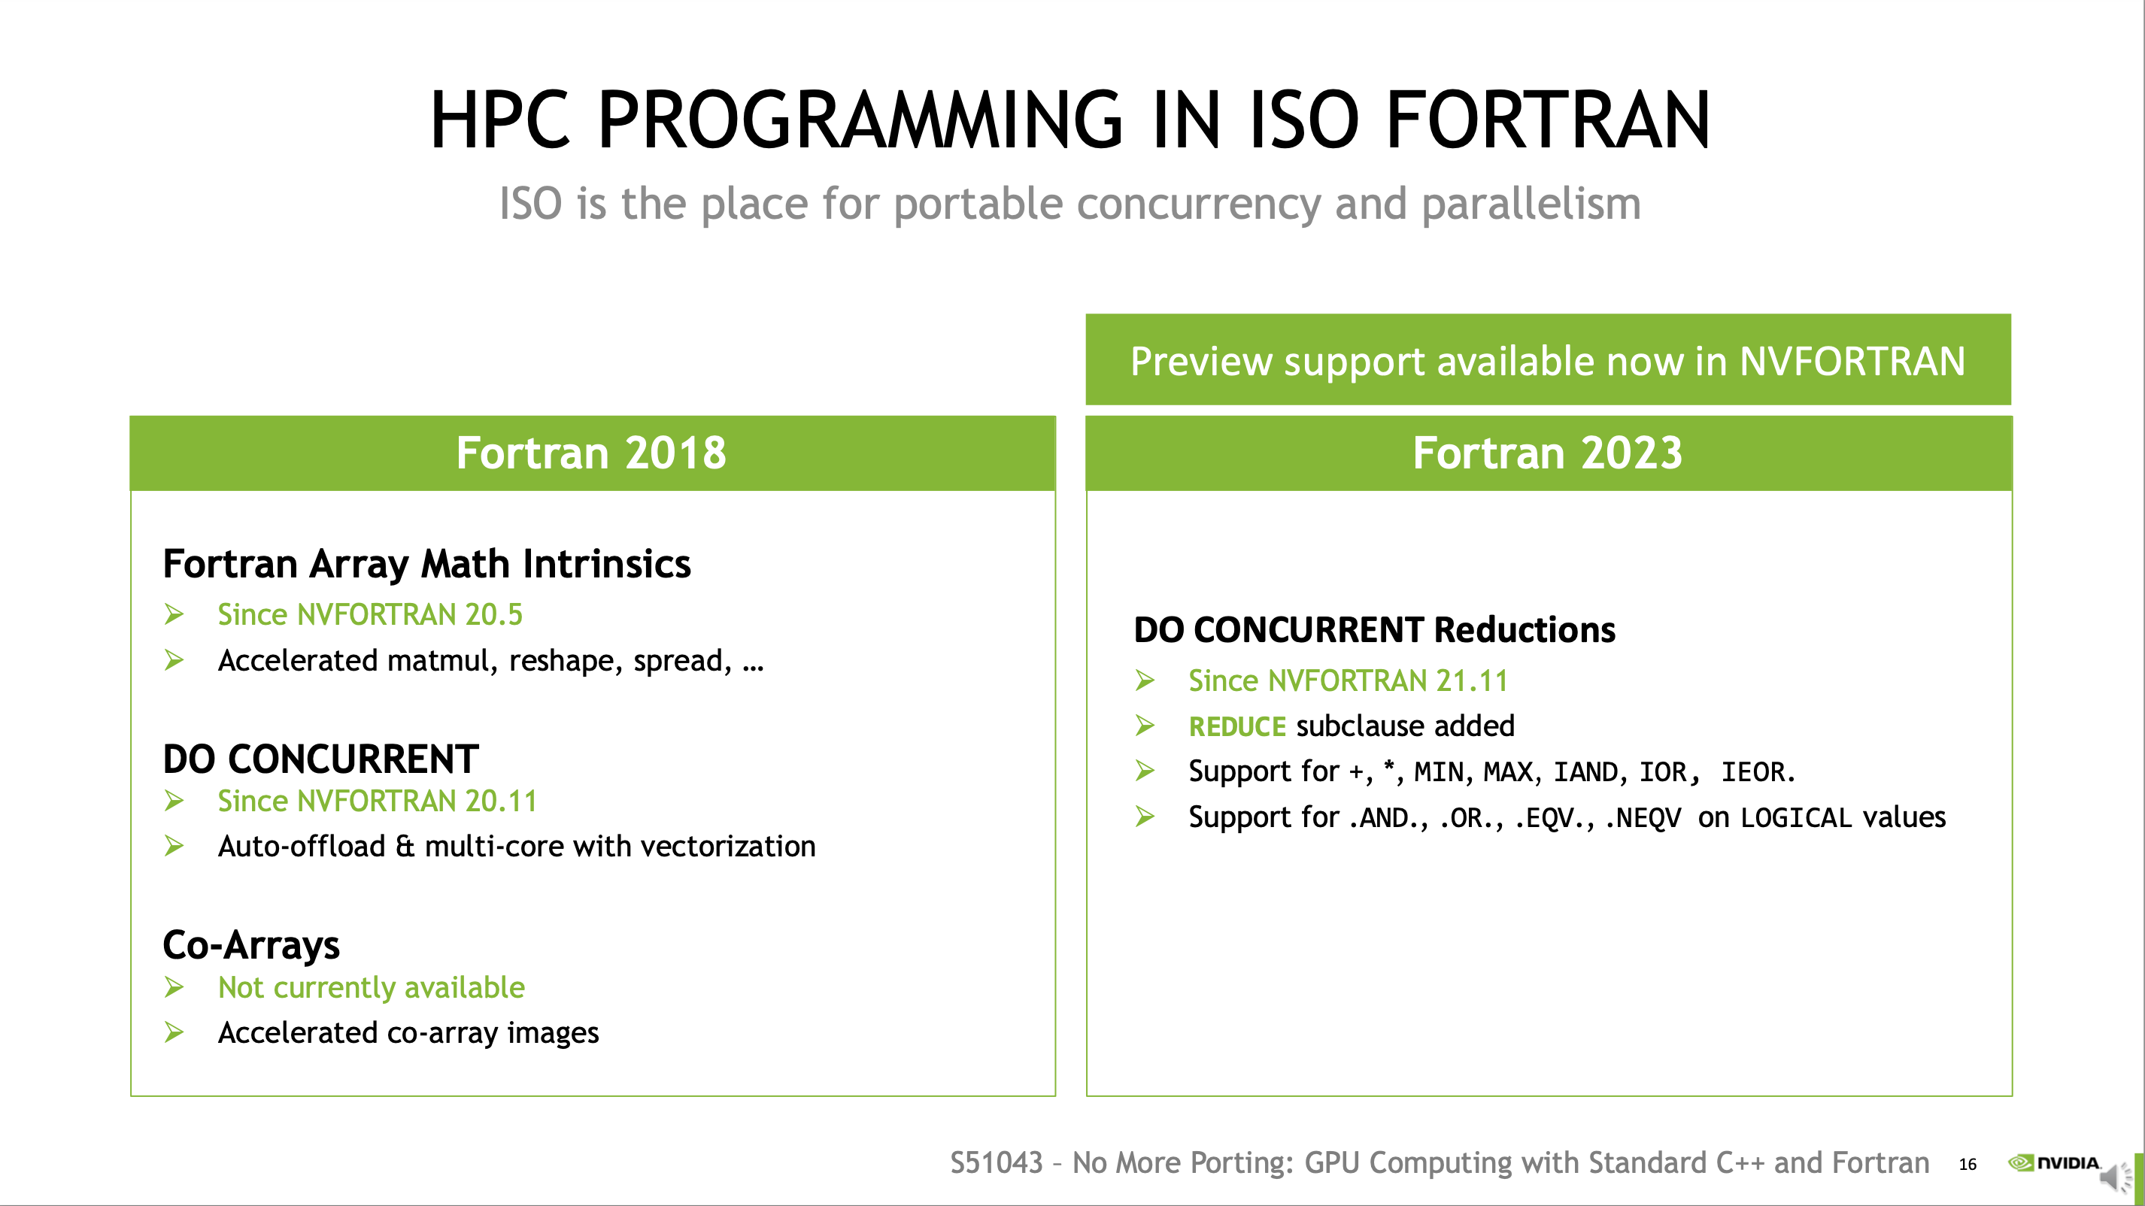
from Pascal architecture

Slide 8
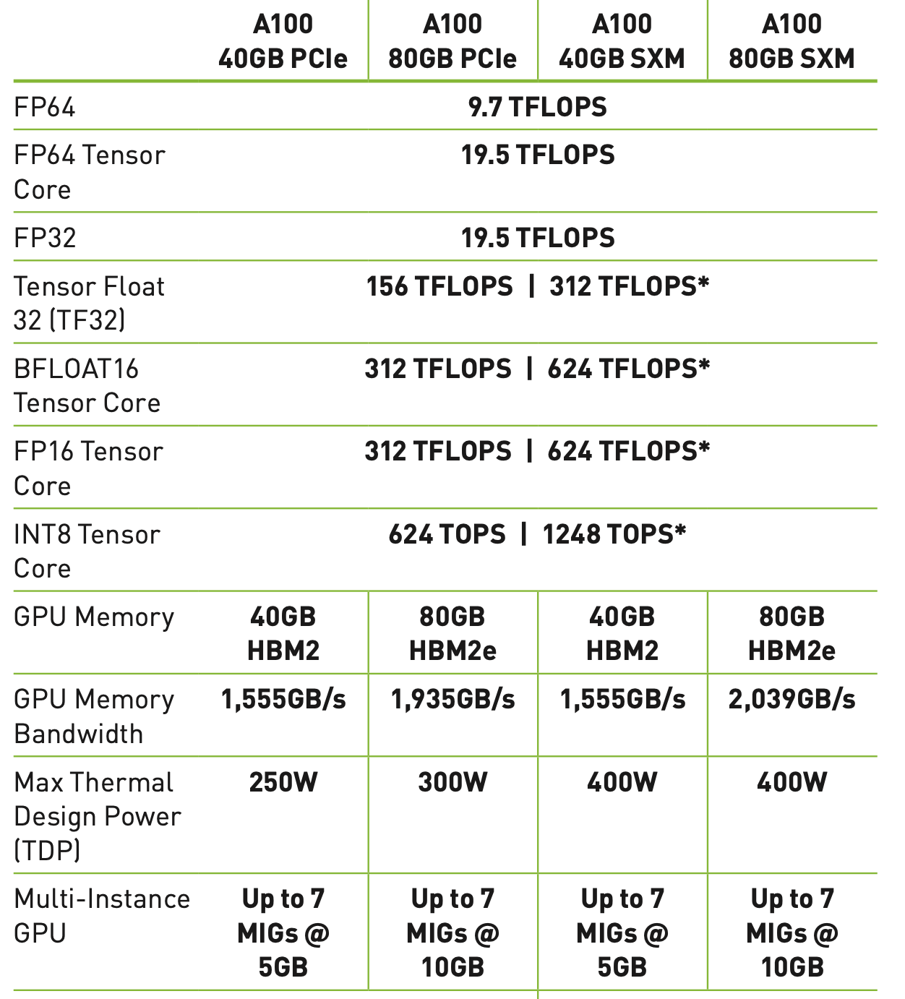
Test bed
Supermicro SYS-4028GR-TRT
NVIDIA A100 40GB PCIe
NVIDIA HPC SDK 23.5

Slide 9
Fortran examples
cutensor.f90
addVectors.90
dotProduct.f90
matmul.f90
jacobi.f90

Slide 10
AI (Arithmetic Intensity)
Definition: number of operations per byte
AI for a[N]+b[N]
N ops / 8N bytes = 1/8
AI for A[N][N] * B[N][N]
2N³ ops/ 8N² bytes = N/4
If AI ~ 1, performance = AI x memory BW
If AI >> 1 better performance

Slide 11
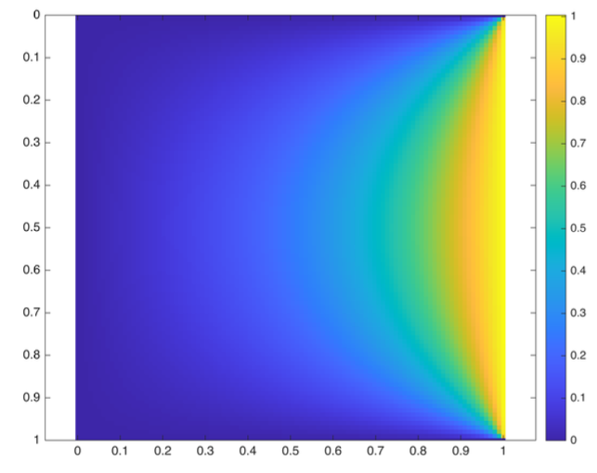



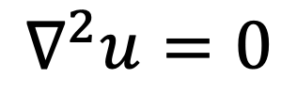


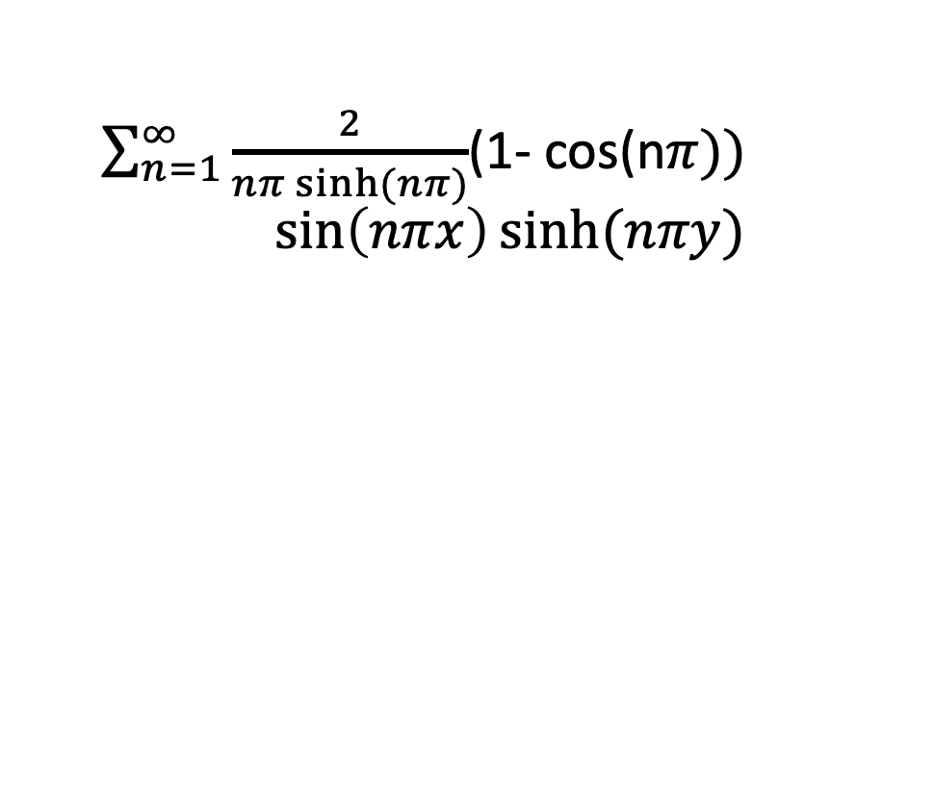


Analyticcal solution to Laplace equation
$\sum_{n=1}^{∞}{\frac{2}{nπ sinh⁡(nπ)}}$(1- cos(n$π))$
$$\sin\left(nπx\right)sinh(nπy)$$
$$∇^{2}u=0$$
Boundary Condition
$$(0,1)$$
$$u=0$$
$$(1,1)$$
$$u=0$$
$$u=1$$
$$(0,0)$$
$$u=0$$
$$(1,0)$$

Slide 12
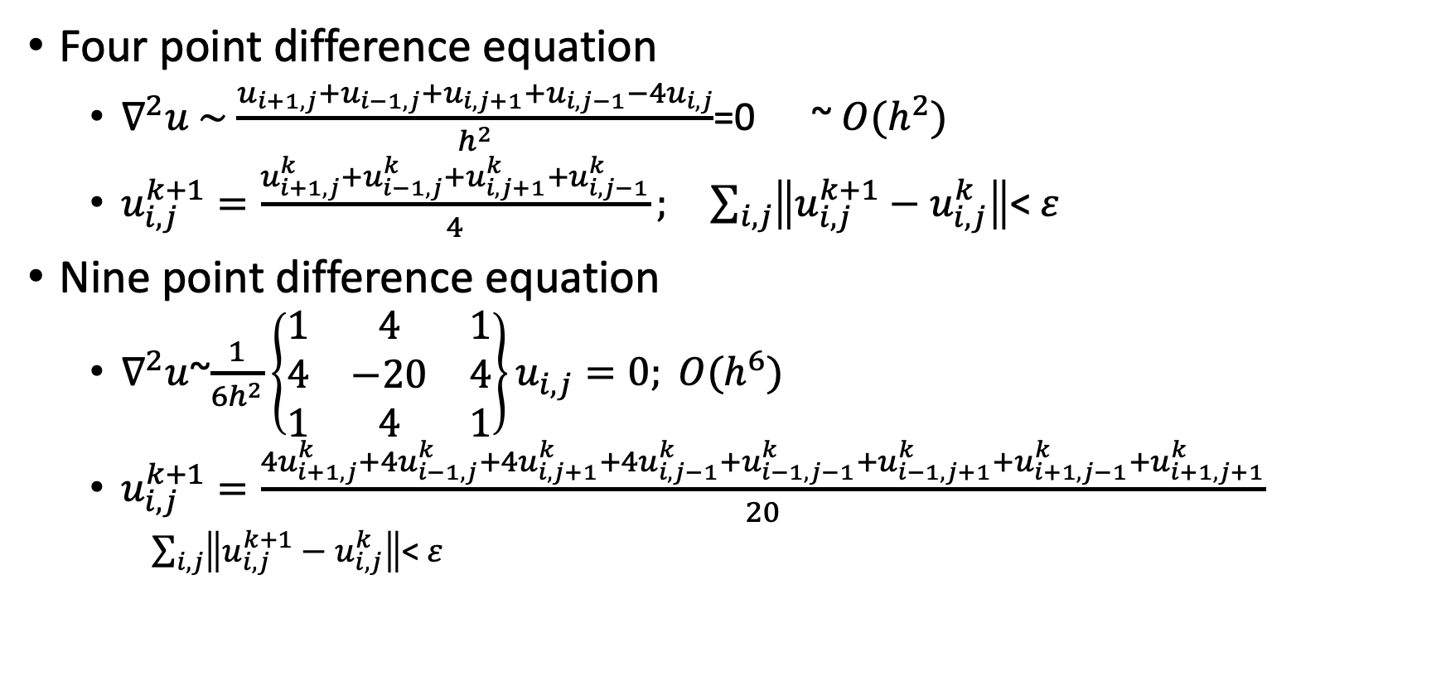
Jacobi method to Laplace equation
Four point difference equation
$∇^{2}u \sim$ $\frac{u_{i+1,j}+u_{i−1,j}+u_{i,j+1}+u_{i,j−1}−4u_{i,j}}{h^{2}}$=0 ~ $O(h^{2})$
$u_{i,j}^{k+1}=\frac{u_{i+1,j}^{k}+u_{i−1,j}^{k}+u_{i,j+1}^{k}+u_{i,j−1}^{k}}{4}; \sum_{i,j}{\left\|u_{i,j}^{k+1}−u_{i,j}^{k}\right\|}$< $ε$
Nine point difference equation
$∇^{2}u$~$\frac{1}{6h^{2}}\left\{\begin{matrix}1 & 4 & 1 \\ 4 & −20 & 4 \\ 1 & 4 & 1\end{matrix}\right\}u_{i,j}=0; O(h^{6})$
$u_{i,j}^{k+1}=\frac{{4u}_{i+1,j}^{k}+4u_{i−1,j}^{k}+{4u}_{i,j+1}^{k}+4u_{i,j−1}^{k}+u_{i−1,j−1}^{k}+u_{i−1,j+1}^{k}+u_{i+1,j−1}^{k}+u_{i+1,j+1}^{k}}{20}$
$\sum_{i,j}{\left\|u_{i,j}^{k+1}−u_{i,j}^{k}\right\|}$< $ε$

Slide 13
Matlab script
u = zeros(100, 100);
for n = 1:200 u = u + 2 / (n * pi * sinh(n * pi)) * (1 - cos(n * pi)) ... * sin(n * pi * linspace(0, 1, 100)') * sinh(n * pi * linspace(0, 1, 100)); end
% Compute the x and y axis limits
xLimits = [0, 1]; yLimits = [0, 1];
% Generate the color image plot
imagePlot = imagesc(xLimits, yLimits, u);
% Set the x and y axis limits
xlim(xLimits); ylim(yLimits);
% Add a color scale
colorbar;
% Adjust the aspect ratio to match the image size
axis equal;

Slide 14
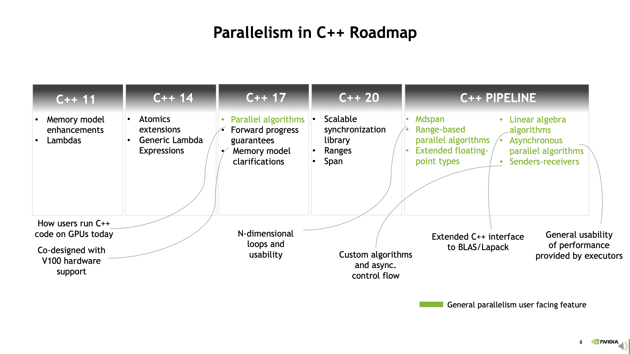

Slide 15
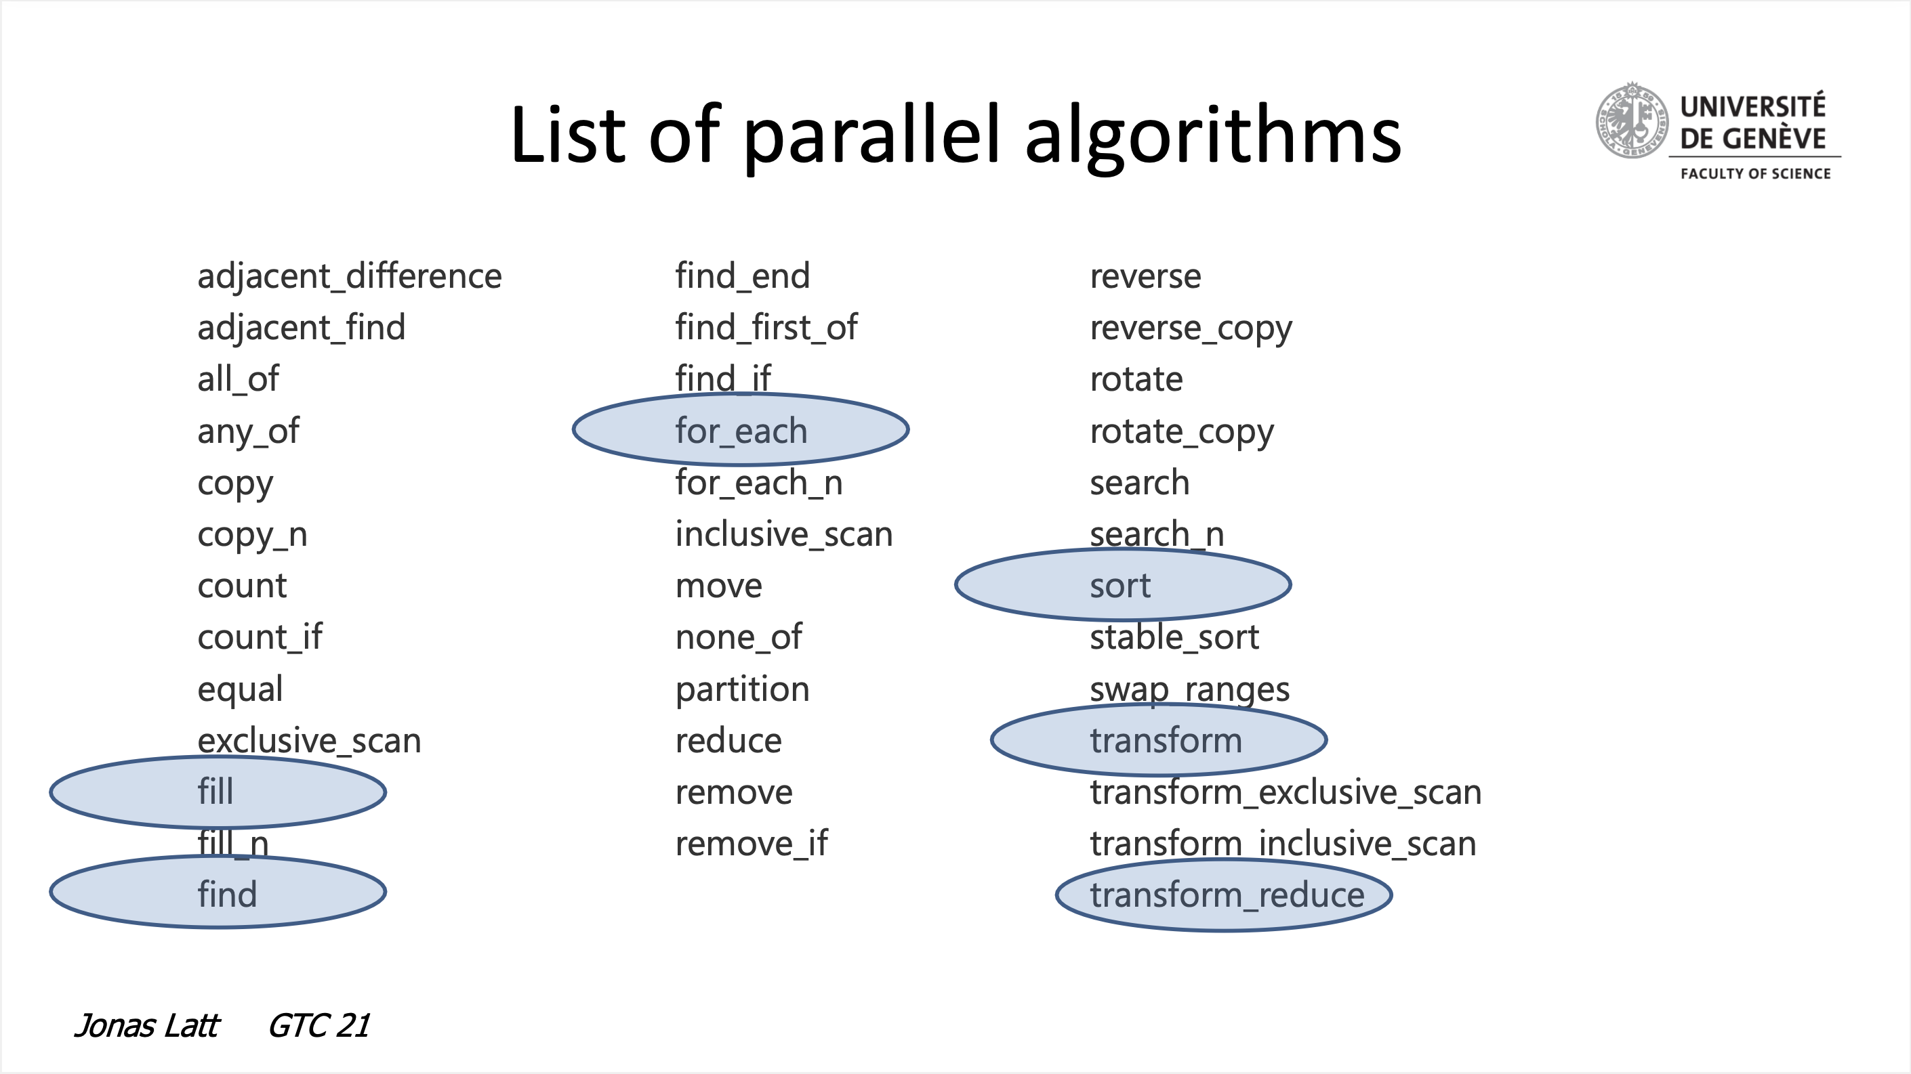

Slide 16
Four Execution Policies
std::execution::seq: Sequential execution. No parallelism is allowed.
std::execution::unseq: Vectorized execution on the calling thread (this execution policy was added in C++20).
std::execution::par: Parallel execution on one or more threads.
std::execution::par_unseq: Parallel execution on one or more threads, with each thread possibly vectorized.

Slide 17
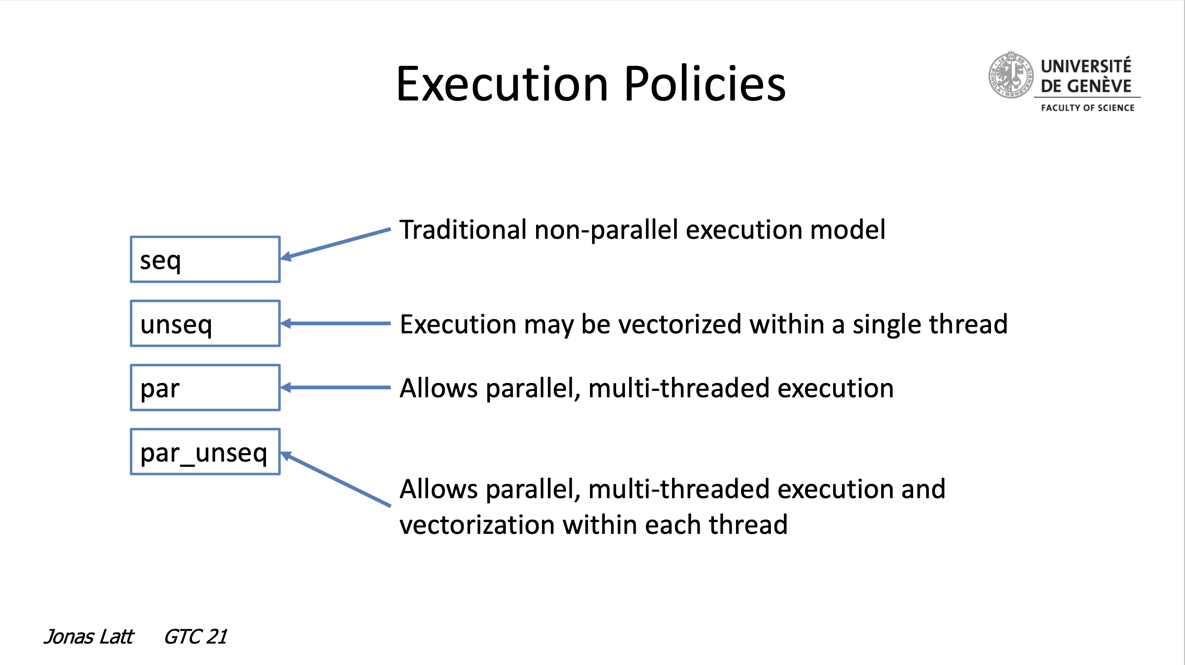

Slide 18
C++ lambda
lambda expression is a convenient way to define anonymous functions, also known as closures. Lambdas allow you to define small, inline functions without having to explicitly declare a separate function.
The syntax for a lambda expression in C++ is as follows:
[capture list](parameters) -> return_type {
// Function body
}

Slide 19
Capture list: It allows you to capture variables from the surrounding context. Variables can be captured by value ([var]) or by reference ([&var]). Multiple variables can be captured by separating them with commas ([var1, &var2]). The capture list is optional, and if you don't need to capture any variables, you can omit it.
Parameters: The parameters define the input to the lambda function, similar to regular function parameters. They follow the same syntax as a function, enclosed in parentheses. If the lambda takes no parameters, you can use empty parentheses () or omit them altogether.
Return type: The return type specifies the type of the value returned by the lambda function. It is optional, and if omitted, the return type is deduced automatically based on the return statement(s) in the function body. However, if the function body contains more than one return statement with different types, you must explicitly specify the return type.
Function body: It contains the code that makes up the lambda function. It can include any valid C++ statements and expressions. The function body is enclosed in curly braces {}.

Slide 20
Stack memory
The stack is a region of memory used for the execution of functions and the management of local variables. It is a Last-In-First-Out (LIFO) data structure, meaning that the most recently pushed data is the first to be popped off the stack. Each time a function is called, a new stack frame is created to store local variables, function arguments, and return addresses. When the function execution is completed, the stack frame is removed, and control returns to the calling function. Stack memory is managed automatically by the compiler or the runtime environment.
Key characteristics of stack memory:
Relatively small in size compared to the heap.
Fast allocation and deallocation of memory.
Memory allocation and deallocation are handled automatically by the system.
Variables in the stack have a limited scope and lifetime.

Slide 21
Heap Memory
The heap is a region of memory used for dynamic memory allocation, where data can be allocated and deallocated in a more flexible manner. Unlike the stack, the heap memory is not automatically managed by the system and requires explicit allocation and deallocation. Heap memory is typically used for larger data structures, such as objects, arrays, or structures, whose size may not be known at compile-time or whose lifetime extends beyond a single function call.
Key characteristics of heap memory:
Larger in size compared to the stack.
Slower allocation and deallocation compared to the stack.
Manual management of memory allocation and deallocation (e.g., using functions like malloc and free in C/C++ or new and delete in languages like C++ and Java).
Memory blocks on the heap can be allocated and deallocated in any order.
Variables on the heap can have a longer lifetime than those on the stack.
Improper management of heap memory can lead to issues like memory leaks or dangling pointers.

Slide 22
4.2 parallel algorithms and Unified Memory
https://docs.nvidia.com/hpc-sdk/compilers/c++-parallel-algorithms/index.html
Currently, only data dynamically allocated on the heap in CPU code that was compiled by NVC++ can be managed automatically. Memory dynamically allocated in GPU code is only visible from GPU code and can never be accessed by the CPU. Likewise, CPU and GPU stack memory and memory used for global objects on most systems cannot be automatically managed. Likewise, data that is dynamically allocated in program units not compiled by NVC++ with the -⁠stdpar option is not automatically managed by CUDA Unified Memory, even though it is on the CPU heap.
As a result, any pointer that is dereferenced and any object that is referenced within a C++ Parallel Algorithm invocation must refer to the CPU heap. Dereferencing a pointer to a CPU stack or a global object results in a memory violation in GPU code.

Slide 23
Captured by reference or value
void saxpy(float* x, float* y, int N, float a) { std::transform(std::execution::par_unseq, x, x + N, y, y, [=](float xi, float yi){ return a * xi + yi; }); }
& (wrong) the function parameter a is captured by reference, which is in CPU stack memory
= (right) the function parameter a is captured by value, which is in CPU heap memory

