Slide 1
CUDA Fortran and C/C++ Programing using chatGPT
Jongsoo Kim
Korea Astronomy and Space Science Institute
@Learning Lab meeting

Slide 2
NVIDIA Tesla GPU Performance
Tesla H100:
single precision 60 Tflops
Hopper
Tesla A100:
single precision 19.5 Tflops
Ampere
Tesla V100:
single precision 15.7 Tflops
Tesla P100:
single precision 10.6Tflops
Tesla K40:
single precision 5.04Tflops

Slide 3
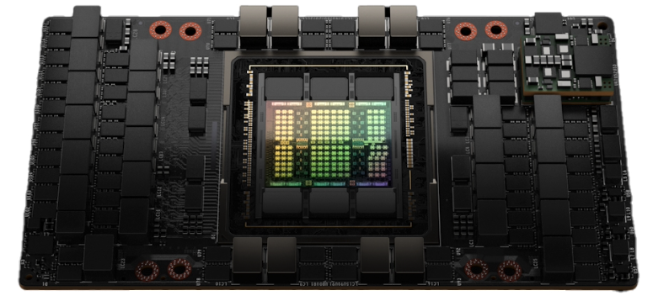
NVIDA TESLA H100 SXM5
Hopper Architecture
Cores: 16896 FP32+432 Tensor
Memory: 80 GB HBM3
4th Gen NVLink: 900 GB/s
PCIe gen5: 128 GB/s
Max Power: 700 W
30 TFLOPS using FP64
60 TFLOPS using FP32
120 TFLOPS using FP16
500 TFLOPS using FP32 Tensor Core

Slide 4
CUDA from Wikipedia
CUDA (an acronym for Compute Unified Device Architecture) is a parallel computing platform and application programming interface(API) model created by Nvidia.
It allows software developers and software engineers to use a CUDA-enabled graphics processing unit(GPU) for general purpose processing – an approach termed GPGPU(general-purpose computing on graphics processing units).
The CUDA platform is a software layer that gives direct access to the GPU's virtual instruction set and parallel computational elements, for the execution of compute kernels.

Slide 5
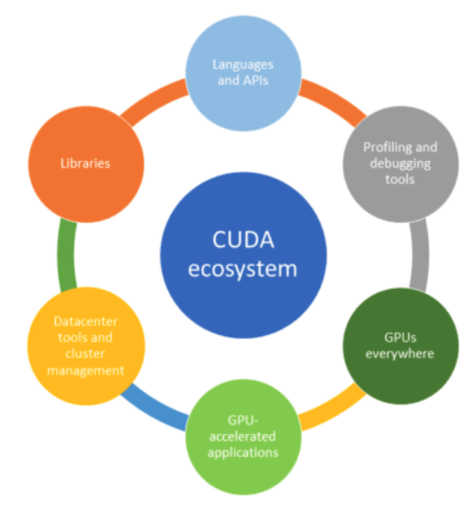
CUDA Ecosystem
Programming languages and APIs
  CUDA: C, C++, Fortran, Python, etc.
Libraries
  Mathematical libraries: cuBLAS, cuRAND, cuFFT, cuSPARSE, cuTENSOR, cuSOLVER
  Parallel algorithm libraries: nvGRAPH, Thrust
  Image and video libraries: nvJPEG, NPP, Optical Flow SDK
  Communication libraries: NVSHMEM, NCCL
  Deep learning libraries: cuDNN, TensorRT, Jarvis, DALI
  Partner libraries: OpenCV, FFmpeg, ArrayFire, MAGMA
Profiling and debugging tools
  NVIDIA Nsight: profiling, tracing, and debugging tool.
  CUDA GDB: extension of Linux GDB, a console-based debugging interface
  CUDA-Memcheck: memory access issues by examining the thousands of threads running concurrently.

Slide 6
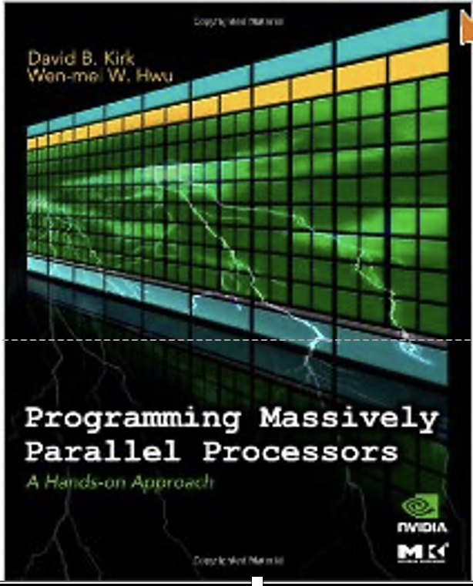
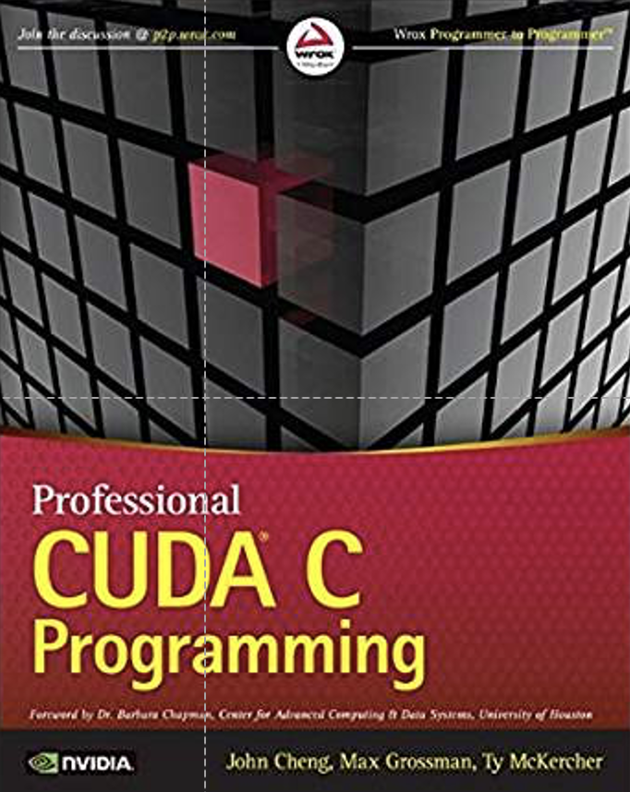
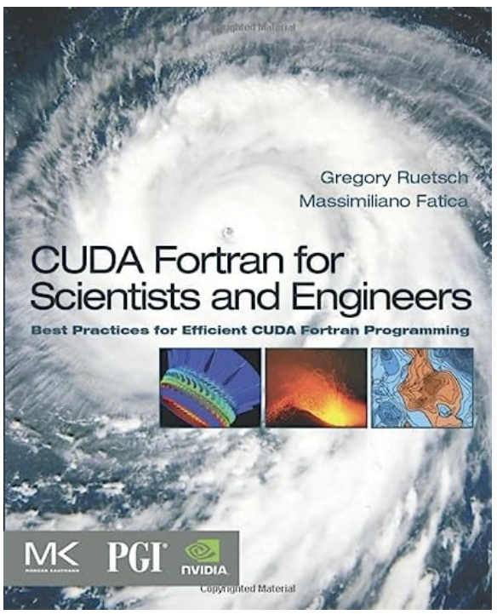
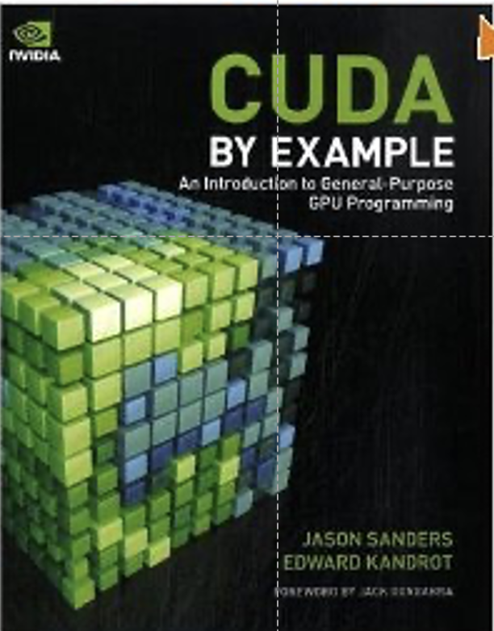

Slide 7
chatGPT; who are you
I am ChatGPT, an AI language model developed by OpenAI. I am designed to assist users in generating human-like text based on the prompts or questions I receive. My purpose is to provide helpful and informative responses to a wide range of inquiries and engage in conversational interactions with users. However, it's important to note that I am an artificial intelligence and do not possess personal identity or consciousness. I am here to provide information and assistance to the best of my abilities based on the training data I have been provided.

Slide 8
Q: how could you help me in programming?
As an AI language model, I can assist you with various aspects of programming. Here are a few ways I can help:
Syntax and language: I can provide guidance on the syntax and usage of programming languages such as C, Python, Java, JavaScript, and more. If you have questions about specific language features, data types, control structures, or functions, feel free to ask.
Code review and debugging: If you have existing code that is not working as expected, you can share it with me, and I can help identify potential issues or suggest improvements. I can assist you in debugging logic errors, finding syntax mistakes, or improving the efficiency of your code.
Algorithm and data structure selection: If you're unsure about which algorithm or data structure to use for a particular problem, I can provide insights and help you understand the trade-offs involved. I can discuss concepts like sorting, searching, graph algorithms, dynamic programming, and more.
Best practices and design patterns: I can share programming best practices and recommend design patterns to make your code more maintainable, modular, and scalable. Whether it's object-oriented programming, functional programming, or software architecture, I can provide guidance.

Slide 9
Q: how could you help me in programming?
General programming concepts: If you need help understanding fundamental programming concepts like loops, conditional statements, functions, recursion, or object-oriented concepts, I can explain these concepts and provide examples to help you grasp them better.
API documentation and usage: If you're working with a specific library or API and need help understanding its documentation or how to use it effectively, I can assist you in navigating the documentation and provide usage examples.
General programming advice: If you have broader questions or need advice on software development methodologies, version control systems, code organization, or project structure, I can provide suggestions and guidance based on industry best practices.
Please keep in mind that while I strive to provide accurate and helpful information, it's always a good idea to double-check and verify any code or advice I provide.

Slide 10
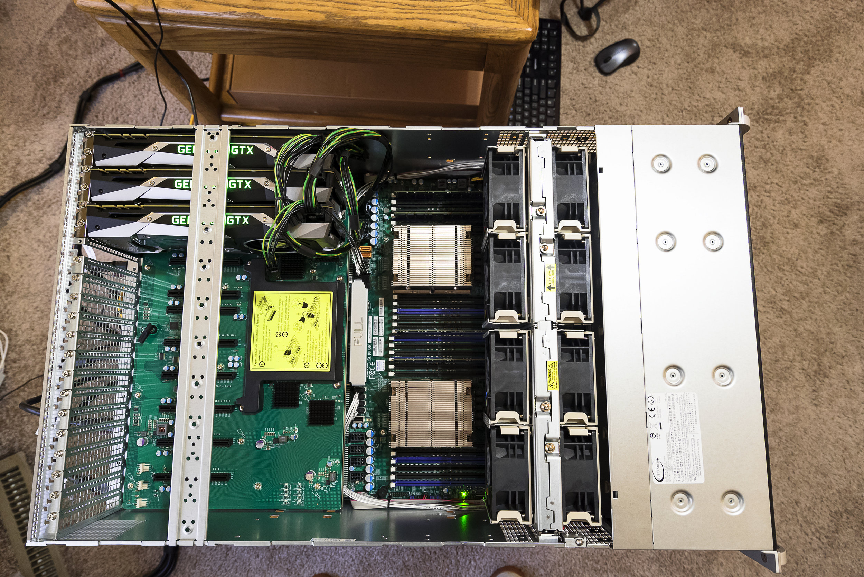
GPU Server
Supermicro SYS-4028GR-TRT
NVIDIA A100 40GB PCIe
NVIDIA HPC SDK 23.5

Slide 11
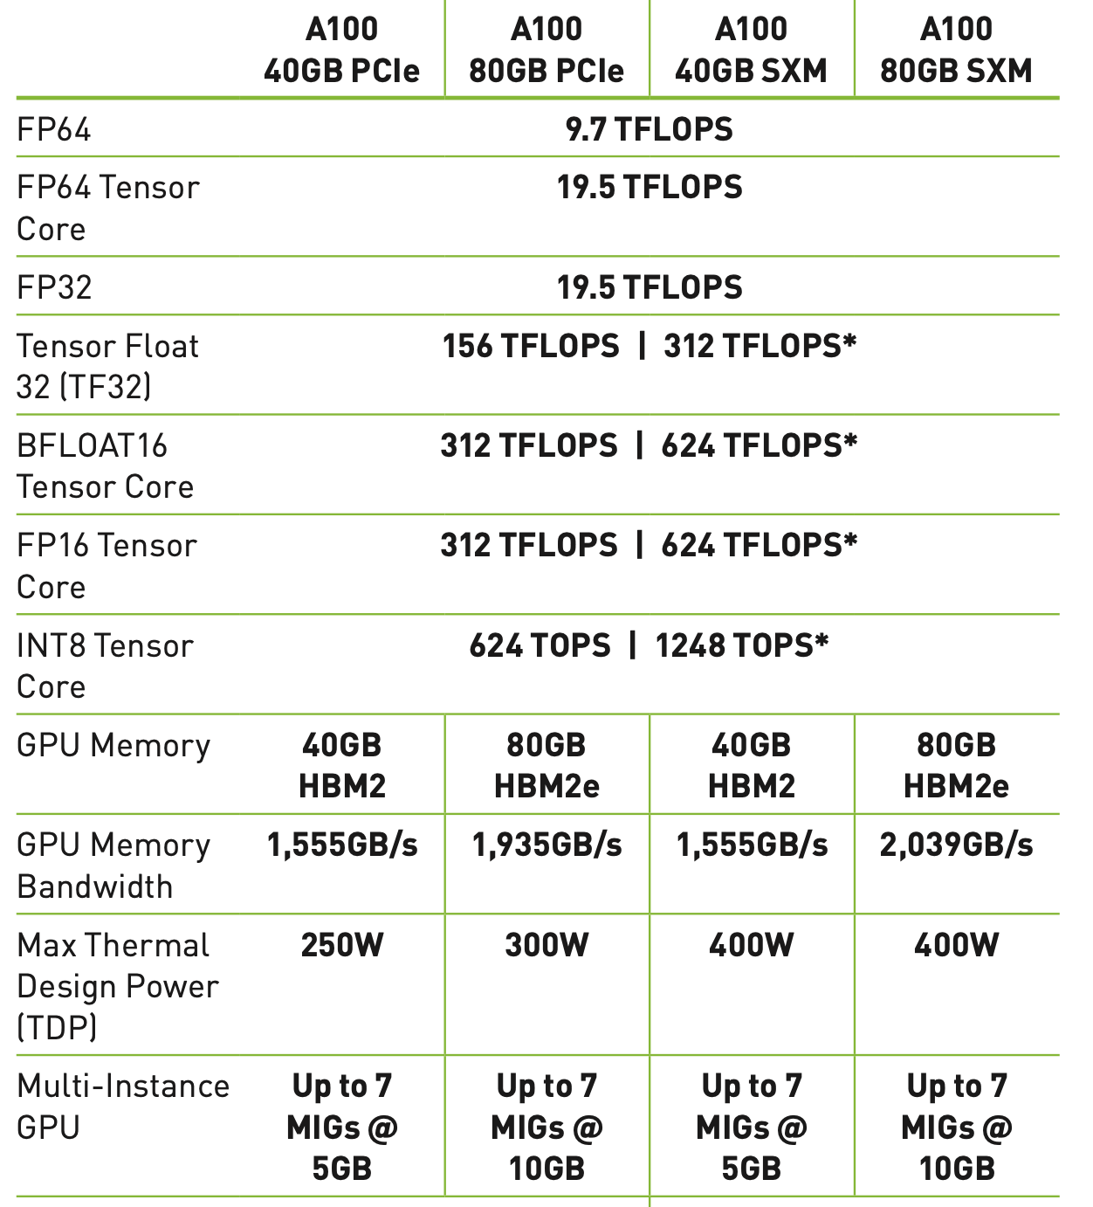
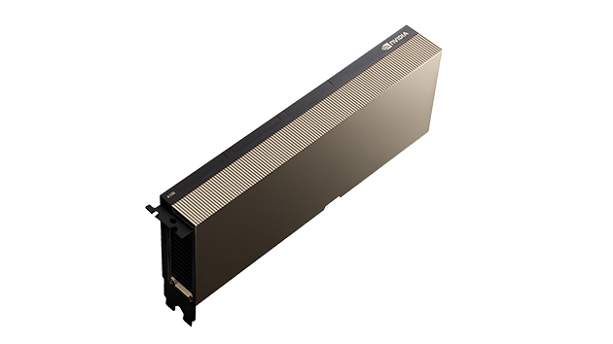
A100 40GB PCI

Slide 12
Check installed GPUs and Compute Capability
prompt> nvaccelinfo
Device Number: 0
Device Name: NVIDIA A100-PCIE-40GB
Global Memory Size: 42331013120
Number of Multiprocessors: 108
Concurrent Copy and Execution: Yes
Total Constant Memory: 65536
Total Shared Memory per Block: 49152
Registers per Block: 65536
Warp Size: 32
Maximum Threads per Block: 1024
Maximum Block Dimensions: 1024, 1024, 64
Maximum Grid Dimensions: 2147483647 x 65535 x 65535
Memory Clock Rate: 1215 MHz
Memory Bus Width: 5120 bits
L2 Cache Size: 41943040 bytes
Default Target: cc80

Slide 13
A100 peak memory bandwidth and performance
Peak memory bandwidth
  1215x10⁶ (memory clock rate; Hz) *
5120(Memory bus width; bit) / 8 (byte) *
2 (double data rate) / 10^9 (GB) = 1555.2 GB/s
Peak performance
  64 [FP32 cores / SM] * 108 [SMs] * 1.41 [boost clock rate; GHz] *
  2 (fused Multiply-Add; FMA) / 1000 = 19.5 Tflops

Slide 14
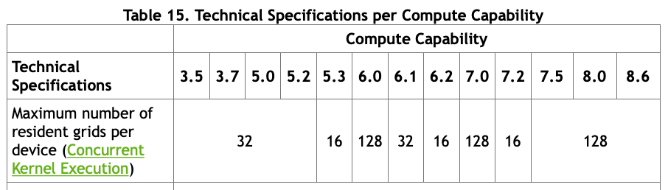
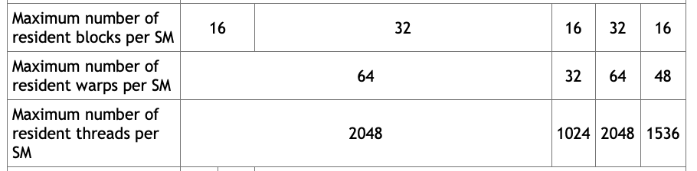
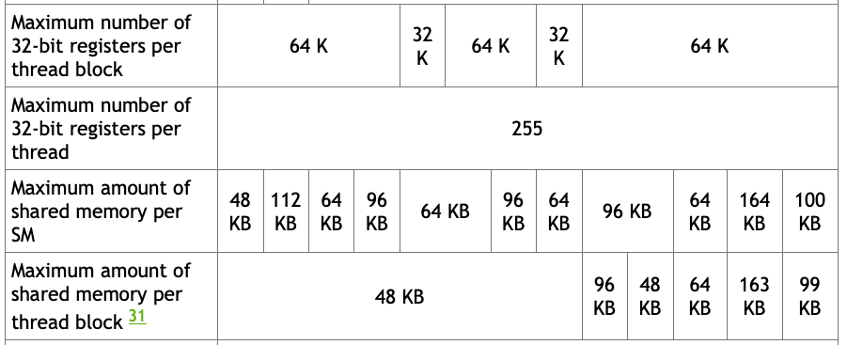
See Table 14 and 15
https://docs.nvidia.com/cuda/cuda-c-programming-guide/index.html#compute-capabilities

Slide 15
Environment settings for HPC SDK
# nvidia HPC SDK
NVARCH=`uname -s`_`uname -m`; export NVARCH
NVCOMPILERS=/opt/nvidia/hpc_sdk; export NVCOMPILERS
PATH=$NVCOMPILERS/$NVARCH/23.5/compilers/bin:$PATH; export PATH

Slide 16
Copy programs to your home directory
ssh –p 7774 guest@203.250.156.41
cd ~
cp –r ~jskim/CUDA/cuda_tutorial/ .

Slide 17
Exercise: Hello world
hello_world.c
hello_world.f90
hello_world.cu
hello_world.cuf

Slide 18
Exercise: Hello world
#include <stdio.h>
__global__ void hello_world(void) {
printf(“Hello World\n”);
}
int main (void) {
hello_world<<<1,5>>>();
cudaDeviceReset();
return 0;
}

Slide 19
Compile and Run
nvc++ hello_world.cu
./a.out
  Hello World
  Hello World
  Hello World
  Hello World
  Hello World
Run hello_world.cu with different combinations of numbers in <<<1,5>>>

Slide 20
C++ and Fortran Language Extensions
Function Type Qualifiers
  __global__ (global)
    executed on the device (GPU)
    callable from the host (CPU) only
    functions should have void return type
    any call to a __global__ function must specify the execution configuration for that call
  __device__ (device)
  executed on the device
  callable from the device only
  …

Slide 21
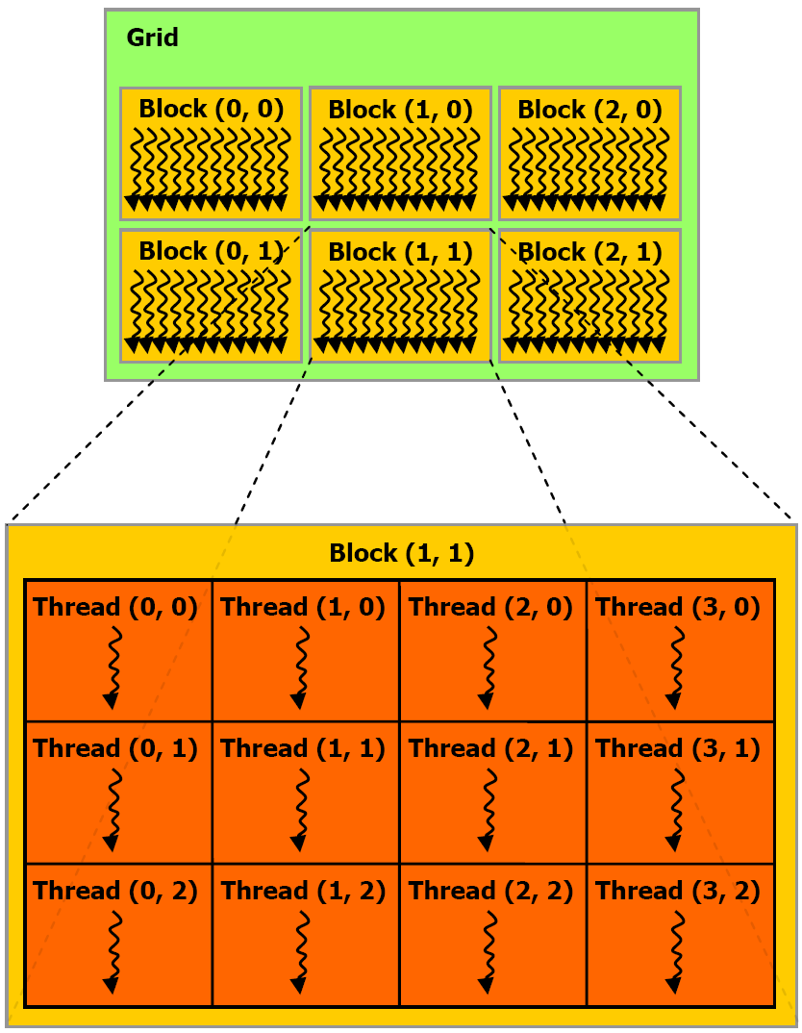
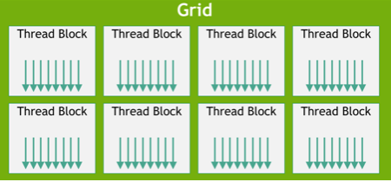
Grid, Block, Thread
One grid generation for one function or subroutine
Block structure could be 1D, 2D or 3D
Thread strcutre could be 1D, 2D or 3D

Slide 22
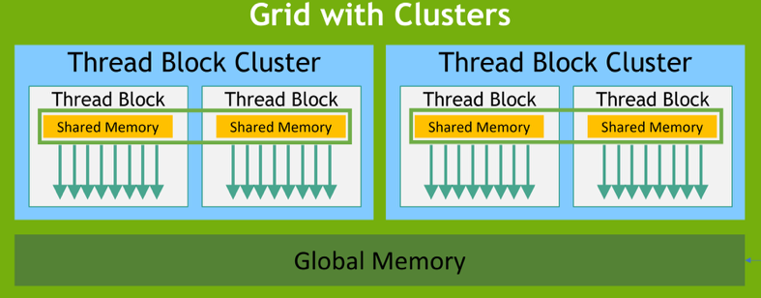
Thread Block Clusters
Introduced Compute Capability 9.0
Threads in a block are co-scheduled on a SM; while blocks in a cluster are co-scheduled on a GPC (GPU Processing Cluster)
Max 8 blocks in a cluster

Slide 23
Built-in variables and vector type
Built-in Variables C/C++, Fortran
  (threadIdx.x, threadIdx.y, threadIdx.z) : thread index in each direction
  (threadidx%x, threadidx%y, threadidx%z)
  (blockIdx.x, blockIdx.y, blockIdx.z) : block index in each direction
  (blockidx%x, blockidx%y, blockidx%z)
  (blockDim.x, blockDim.y, blockDim.z) : number of threads in each direction
  (blockdim%x, blockdim%y, blockdim%z)
  (gridDim.x, gridDim.y, girdDim.z): number of blocks in each direction
  (griddim%x, griddim%y, girddim%z)
Built-in Vector type for both C/C++ and Fortran
  dim3:
    Integer vector type based on unit3 used to specify dimensions

Slide 24
Limitation of # of threads and blocks
Maximum # of threads per block:
threadIdx.x * threadIdx.y * threadIdx.z < 1024
Maximum # of threads of each block dimension
threadIdx.x or threadIdx.y< 1024; threadIdx.z < 64
Maximum # of blocks of each grid dimension
blockIdx.x < 2147483647; blockIdx.y or blockIdx.z < 65535

Slide 25
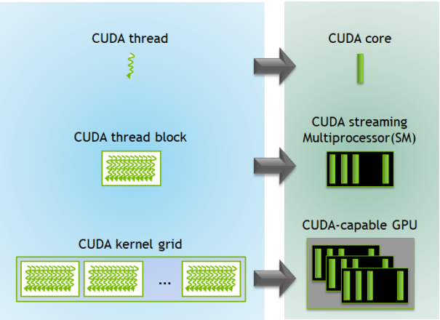
Threads vs. Cores
https://developer.nvidia.com/blog/cuda-refresher-cuda-programming-model/

Slide 26
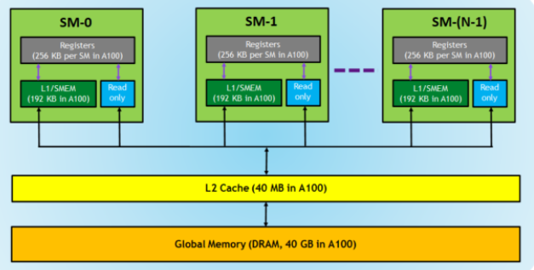
Memory Hierarchy
https://developer.nvidia.com/blog/cuda-refresher-cuda-programming-model/

Slide 27
Execution configuration for C/C++
<<<4,4>>>, blockDim.x=4, GridDim.x=4
blockIdx.x=0
blockIdx.x=1
blockIdx.x=2
blockIdx.x=3
0 | 1 | 2 | 3
0 | 1 | 2 | 3
0 | 1 | 2 | 3
0 | 1 | 2 | 3
threadIdx.x
Index = threadIdx.x + blockIdx.x * blockDim.x
0 | 1 | 2 | 3
4 | 5 | 6 | 7
8 | 9 | 10 | 11
12 | 13 | 14 | 15

Slide 28
Execution configuration for Fortran
<<<4,4>>>, blockdim%x=4, Griddim%x=4
blockidx%x=1
blockidx%x=2
blockidx%x=3
blockIdx.x=4
1 | 2 | 3 | 4
1 | 2 | 3 | 4
1 | 2 | 3 | 4
1 | 2 | 3 | 4
Threadidx%x
Index = threadidx%x + (blockidx%x-1) * blockdim%x
1 | 2 | 3 | 4
5 | 6 | 7 | 8
9 | 10 | 11 | 12
13 | 14 | 15 | 16

Slide 29
Execution configuration (2)
dim3 blocksPerGrid(16,16,1)
dim3 threadsPerBlock(1024,1,1)
<<<blocksPerGrid,threadsPerBlock>>>
dim3 blocks(4096,16,2)
dim3 threads (256,2,2)
<<<blocks,threads>>>

Slide 30
Exercise: Execution Configuration
nvc++ exec_conf_1d.cu
nvfortran exec_conf_1d.cuf
./a.out
nvcc exec_conf_2d.cu
nvfortran exec_conf_2d.cuf
./a.out
Run the two programs with different thread and block numbers in the execution configuration.

Slide 31
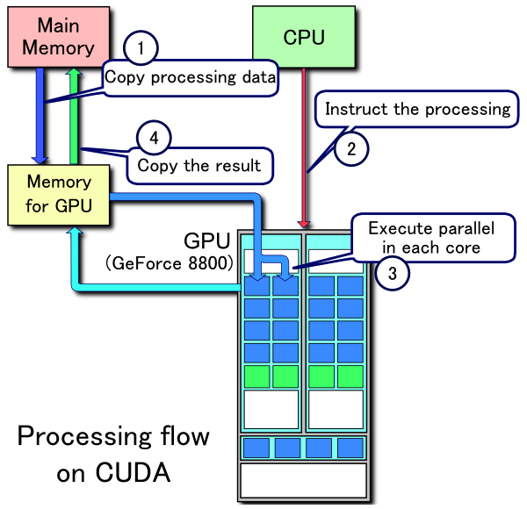
Processing flow

Slide 32
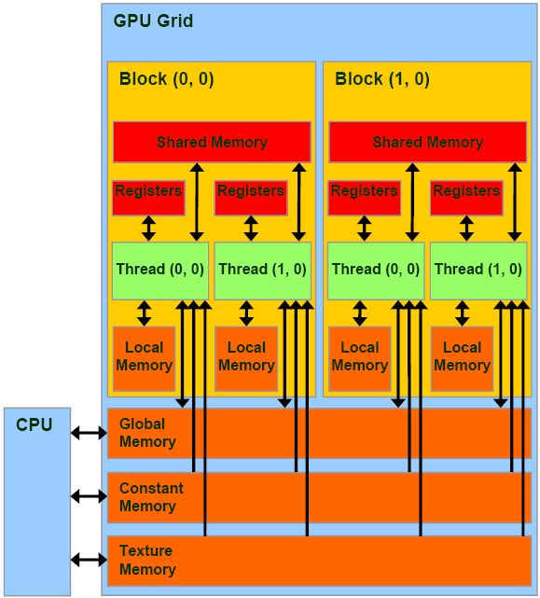
Register
Fastest
Thread scope, thread lifetime
Local
Does not exist
Abstraction of thread scope
Global memory
Implemented in DRAM
High-access latency: 400-800 cycles
Finite bandwidth: 1555GB/sec for A100
Potential of traffic congestion
Grid scope, application lifetime

Slide 33
allocate/deallocate memory on the device
cudaMalloc ( void** devPtr, size_t size )
cudaMallocManaged ( void** devPtr, size_t size, unsigned int flags = cudaMemAttachGlobal )
cudaFree ( void* devPtr )

Slide 34
Data copy between host and device
cudaMemcpy ( void* dst, const void* src, size_t count, cudaMemcpyKind kind );
cudaMemcpyKind
  cudaMemcpyHostToHost
  cudaMemcpyHostToDevice
  cudaMemcpyDeviceToHost
  cudaMemcpyDeviceToDevice
  cudaMemcpyDefault

Slide 35
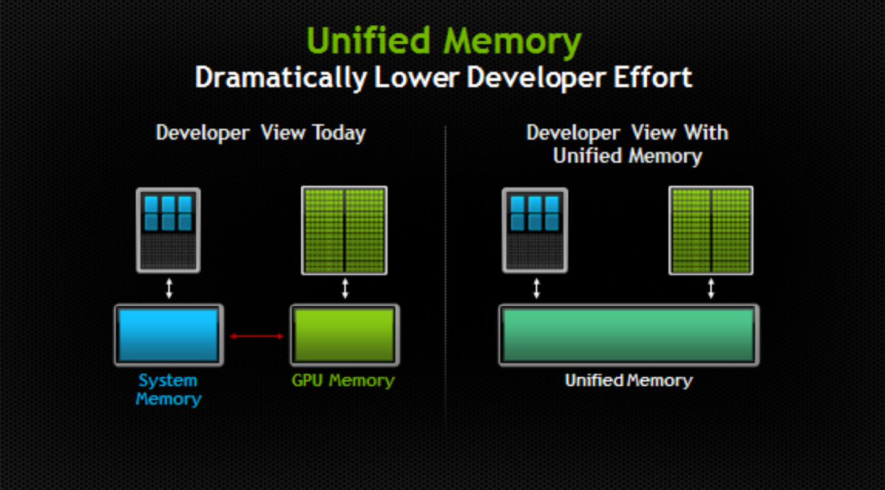

Slide 36

Exercise: Vector sum
$$c_{i}=a_{i}+b_{i}$$
nvc++ vector_addition.c
nvfortran vector_addition.f90
nvc++ -gpu=cc80 -gpu=ptxinfo vector_addition.cu –o vector_addition_comm
nsys profile vecadd_comm –stats=true ./vector_addition_comm
nvc++ -gpu=cc80 –gpu=ptxinfo vector_addition_unmem.cu –o vector_addition_unmem
nsys profile vecadd_unmem –stats=true ./vector_addition_unmem
nvfortran vector_addition.cuf
nvfortran vector_addition.unmem.cuf

Slide 37
Timing using CUDA Events
cudaEvent_t start, stop;
cudaEventCreate( &start );
cudaEventCreate( &stop );
cudaEventRecord( start,0 ); 0 is a default stream id
cudaMemcpy
Kernel
cudaMemcpy
cudaEventRecord(stop, 0);
cudaEventSynchronize(stop);
cudaEventElapsedTime( &etime, start, stop ); etime measured in units of millisecond

Slide 38

Reduction example
sum$=\sum_{i=0}^{N−1}{v_{i}}$
Calculate a sum of each component of a vector.
Since multiple threads are trying to update the sum value, a race condition happens.
Three ways to do reduction
  global memory using atomicAdd
  shared memory
  warp shuffle instruction

Slide 39
several different programs
sumReduction.cpp
sumReductionGmem.cu
sumReductionSmem.cu
sumReductionWarpShfl.cu

Slide 40
Shared memory
Extreme fast, highly parallel
Block scope, kernel lifetime
49152 Bytes for A100
L2 cache
41943040 Bytes for A100

Slide 41
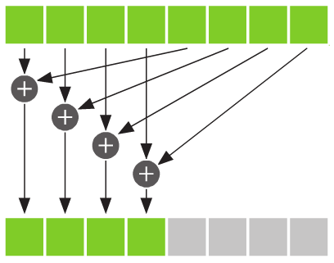

Reduction using shared memory
blockIdx 0
blockIdx 1
$$c=\sum_{i=0}^{N−1}{a_{i}b_{i}}$$
blockIdx 2
blockIdx 3

Slide 42
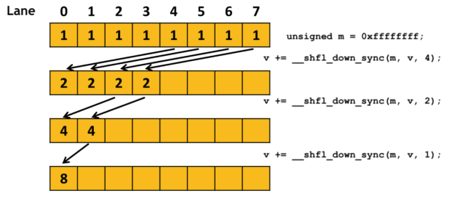
Warp-level parallel reduction

Slide 43
warpSize
8
8
8
8
In a block
Shared in
each block
8 | 8 | 8 | 8 | 8 | 8 | 8 | 8
64 | 64 | …
out

Slide 44

Exercise: Dot-Product
$$c=\sum_{i=0}^{N−1}{a_{i}b_{i}}$$
One example of reduction problems such as SUM, MAX, MIN, …

Slide 45
several different programs
dot_product.c
dot_product.f90
dot_product_glmem.cu
dot_product_shmem.cu
dot_product_glmem.cuf
dot_product_shmem.cuf

Slide 46
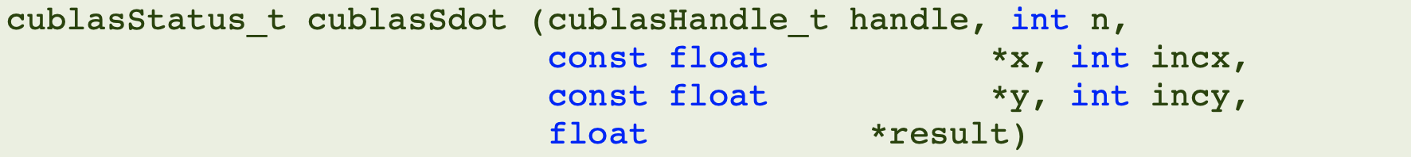
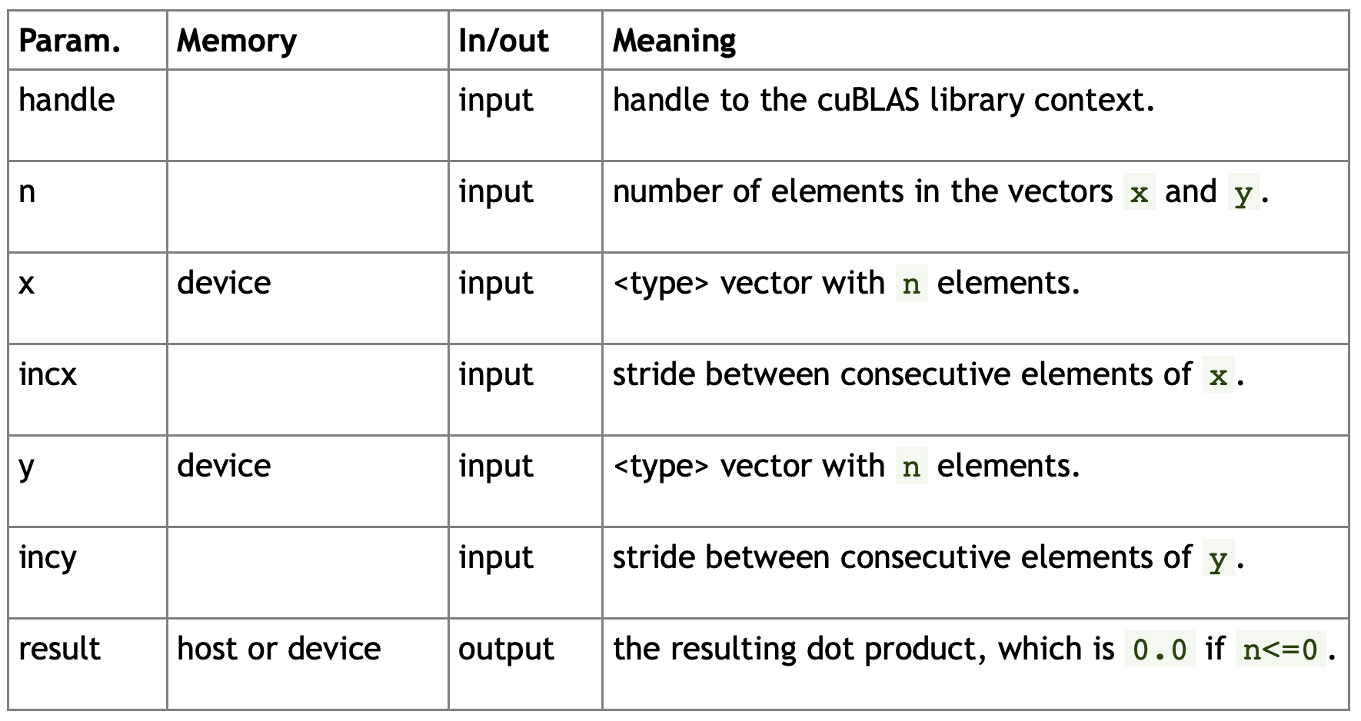
cublasSdot

Slide 47
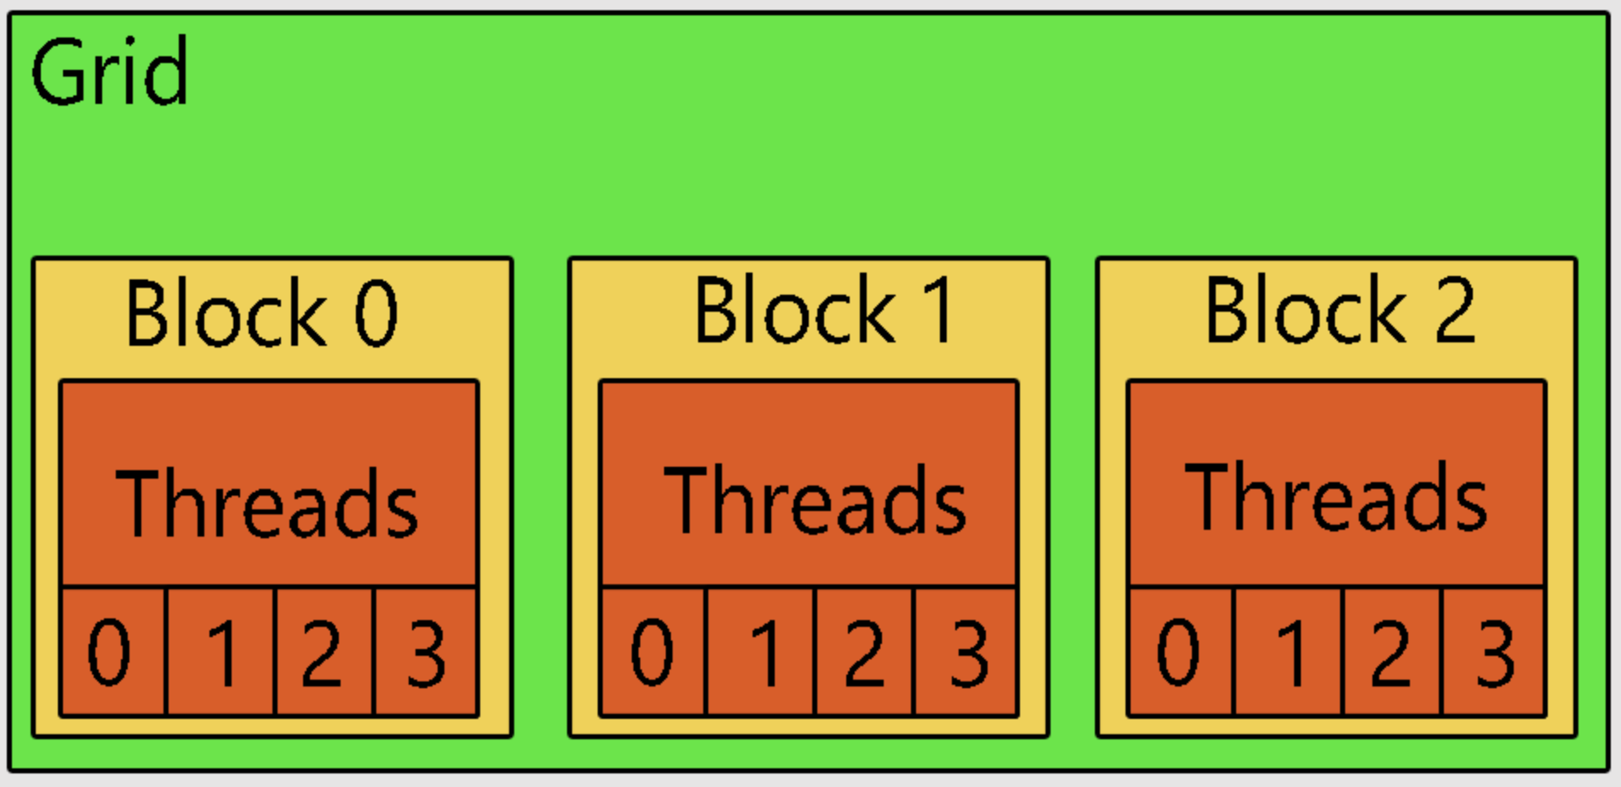
Histogram
too many threads compete each other
histo
G Mem

Slide 48
Histogram
threads within block
compete for a location in shared memory
GridDim of threads compete for a location in
global memory
histo
G Mem

Slide 49
AI (Arithmetic Intensity)
Definition: number of operations per byte
AI for a[N]+b[N]
N ops / 8N bytes = 1/8
AI for A[N][N] * B[N][N]
2N³ ops/ 8N² bytes = N/4
If AI ~ 1, performance = AI x memory BW
If AI >> 1 better performance

Slide 50
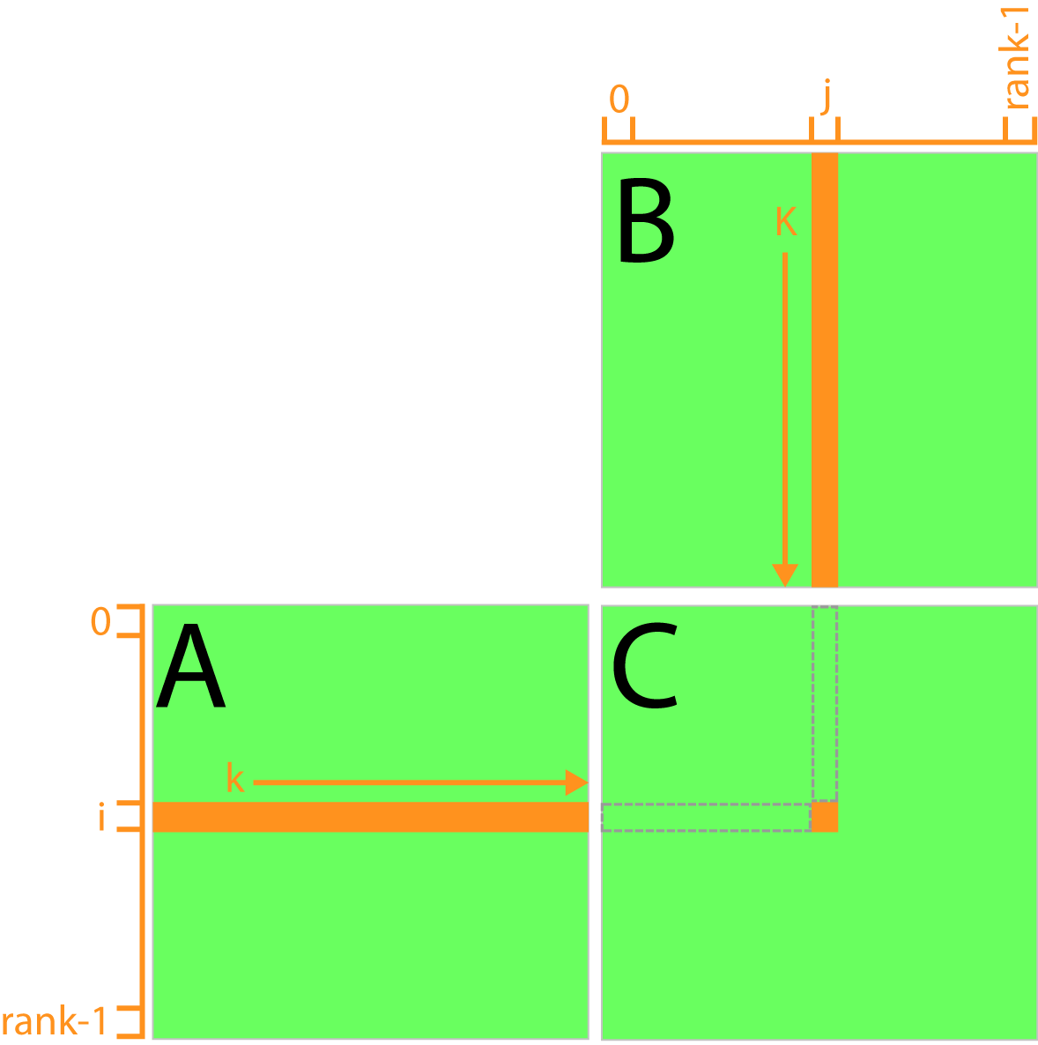
M-M Multiplication: Global

Slide 51
Exercise: Matrix Multiplication
nvc++ matmul.cpp
nvc++ matmul_glmem.cu
nvc++ matmul_shmem.cu
nvc++ matmul_uimem.cu

Slide 52
Reducing Global Memory Traffic
Reducing global memory access enhances performance
tiling: partition of data into subsets called tiles, such that each tile fits into fast (shared) memory

Slide 53
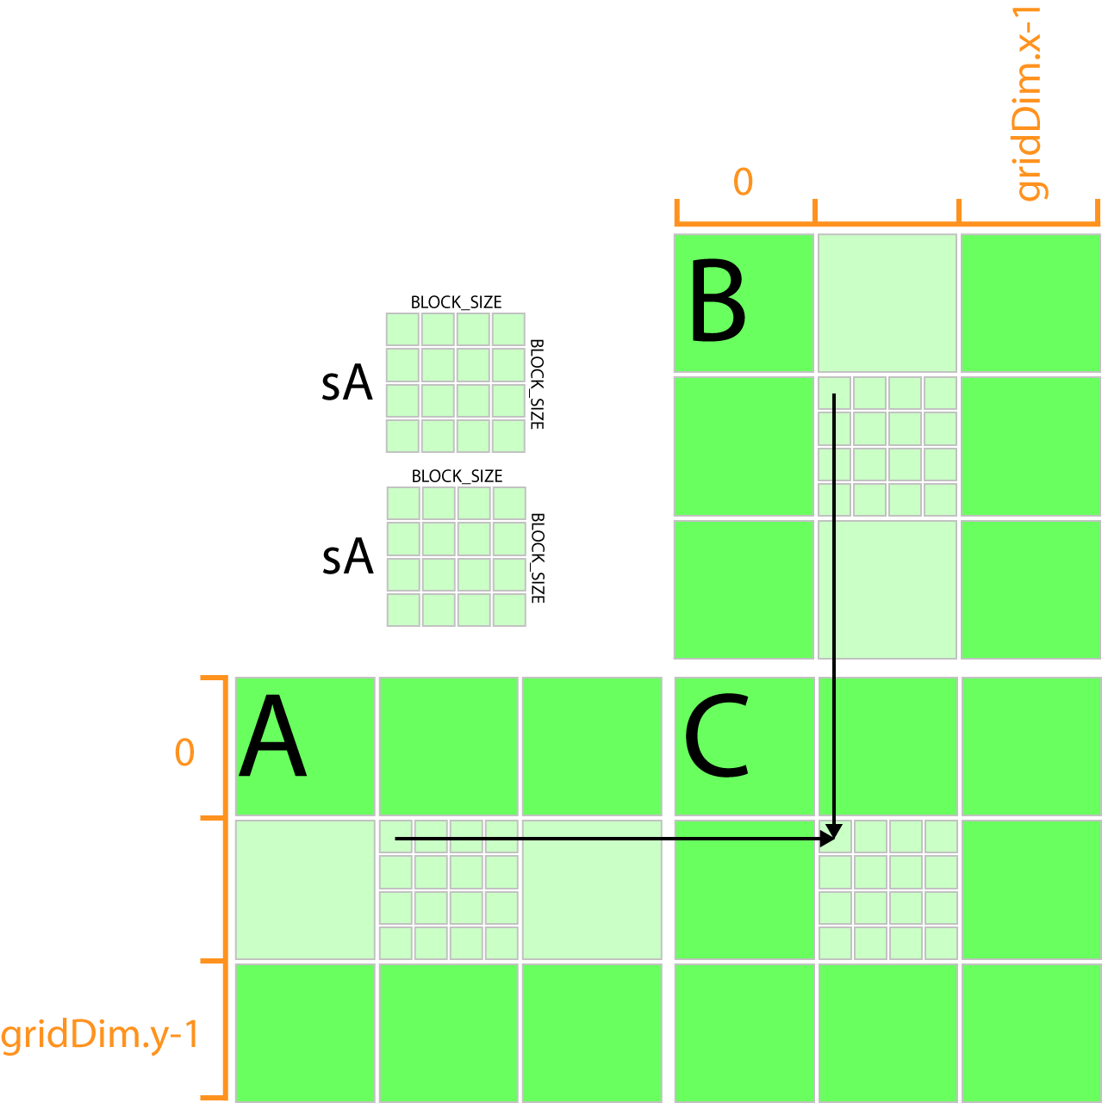
Matrix-Multiplication: shared memory

Slide 54
cuBLAS
cuBLAS: CUDA Basic Linear Algebra Subroutine Library
  cuBLAS API: the application must allocate the required matrices and vectors in the GPU memory space, fill them with data, call the sequence of desired cuBLAS functions, and then upload the results from the GPU memory space back to the host.
  cuBLASXt API: the application may have the data on the Host or any of the devices involved in the computation, and the Library will take care of dispatching the operation to, and transferring the data to, one or multiple GPUs present in the system, depending on the user request.
  cuBLASLt API: a lightweight library dedicated to GEneral Matrix-to matrix Multiply (GEMM) operations with a new flexible API.

Slide 55
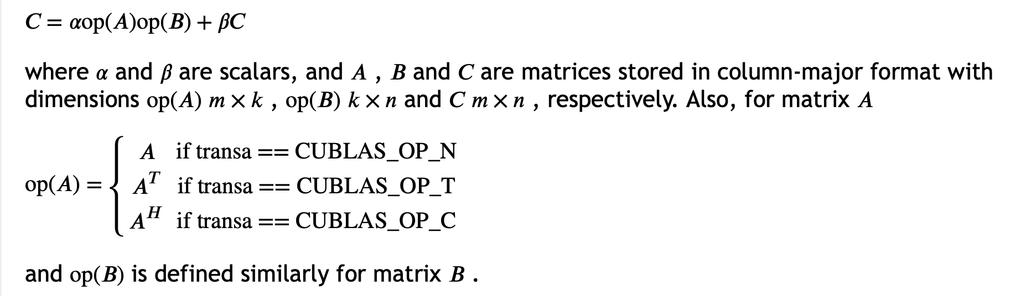
cublasSgeMM
https://docs.nvidia.com/cuda/cublas/index.html#cublas-lt-t-gt-gemm

Slide 56
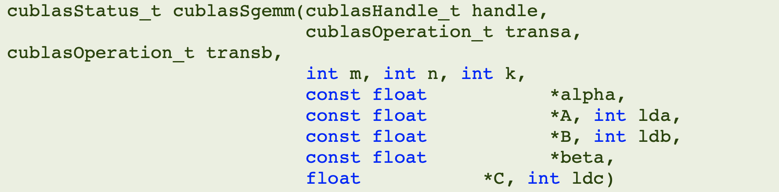
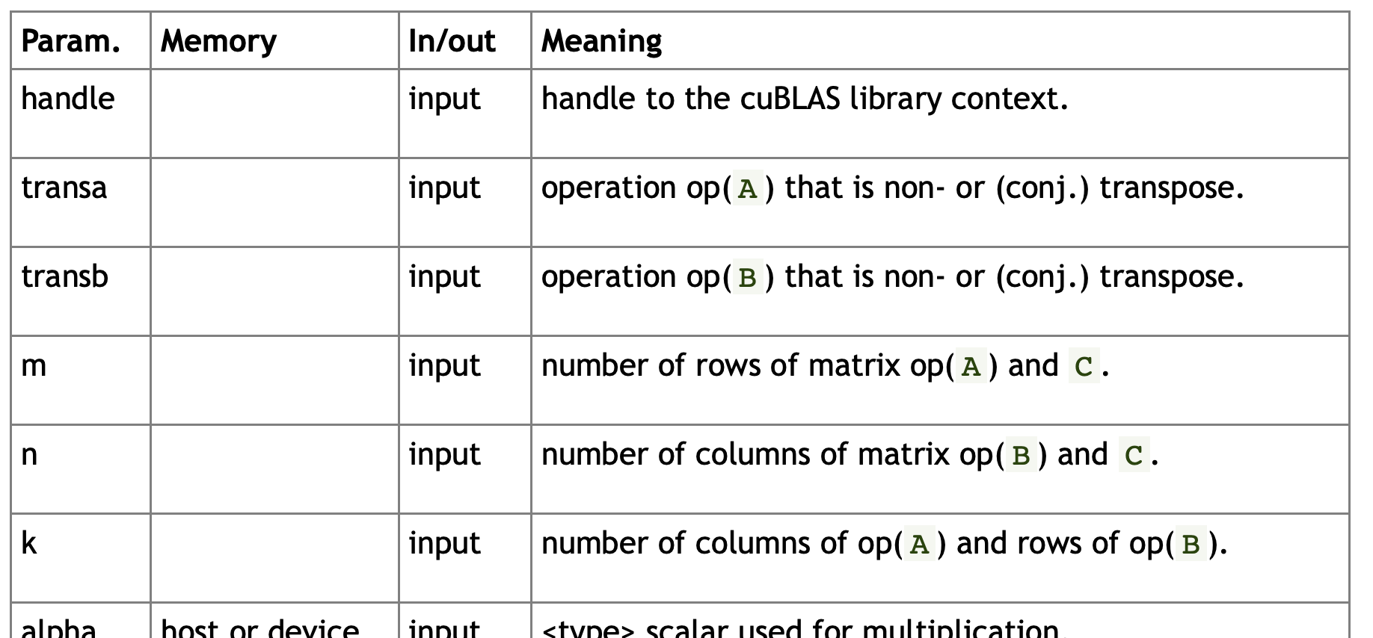

Slide 57
Constant memory
Space for “constant” data during a kernel execution
64kB per a GPU board
Cached on chip
Fast if threads of a half warp reads the same address

Slide 58


Example of
$$\frac{∂f(x,y,z)}{∂x}$$
$\frac{∂f(x,y,z)}{∂x} \sim \frac{4}{5∆x}{(f}_{i+1,j,k}−f_{i−1,j,k})−\frac{1}{5∆x}{(f}_{i+2,j,k}−f_{i−2,j,k})$ $+\frac{4}{105∆x}{(f}_{i+3,j,k}−f_{i−3,j,k})$ -$\frac{1}{280∆x}{(f}_{i+4,j,k}−f_{i−4,j,k}) O(∆x^{8})$
We could learn how to use
  constand memory
  shared memory
  Periodic boundary condition

Slide 59
references
https://developer.nvidia.com/blog/finite-difference-methods-cuda-cc-part-1/
https://developer.nvidia.com/blog/finite-difference-methods-cuda-fortran-part-1/

Slide 60
Texture memory
cached on chip
read only
designed for graphics applications
Optimized 2D “spatial locality”

Slide 61
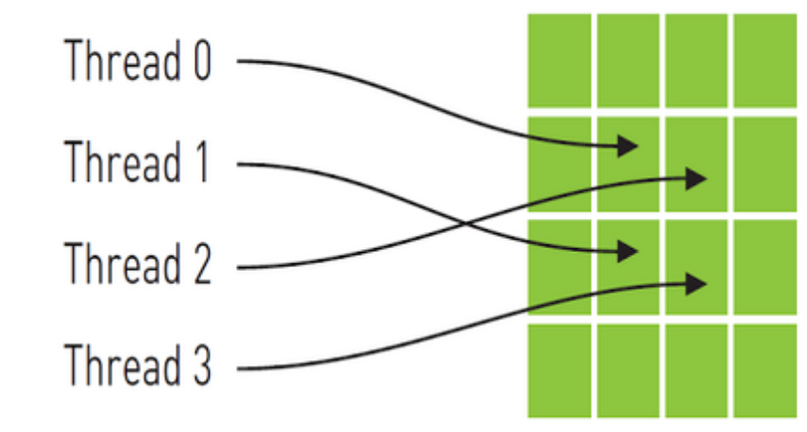
Spatial Locality

Slide 62
Heat equation

Slide 63





$T_{i,−1}$=$T_{i,1}$
$T_{i,N}$=$T_{i,N−2}$
Initial and Boundary Conditions
$T_{N,j}$=$T_{N−2,j}$
● | ● | ● | ● | ● | ● | ● | ● | ● | ●
● | ● | ● | ● | ● | ● | ● | ● | ● | ●
● | ● | ● | ● | ● | ● | ● | ● | ● | ●
● | ● | ● | ● | ● | ● | ● | ● | ● | ●
● | ● | ● | ● | ● | ● | ● | ● | ● | ●
● | ● | ● | ● | ● | ● | ● | ● | ● | ●
● | ● | ● | ● | ● | ● | ● | ● | ● | ●
● | ● | ● | ● | ● | ● | ● | ● | ● | ●
● | ● | ● | ● | ● | ● | ● | ● | ● | ●
● | ● | ● | ● | ● | ● | ● | ● | ● | ●
$$T_{0,0}$$
$T_{−1,j}$=$T_{1,j}$

Slide 64
Exercise 7: heat equation
nvcc heat.c
nvcc heat_global.cu
nvcc heat_texture_1d.cu
nvcc heat_texture_2d.cu

Slide 65
CUDA Streams
https://devblogs.nvidia.com/how-overlap-data-transfers-cuda-cc/
A stream is a sequence of operations that execute on the device in the order in which they are issued by the host code.
Operations in different streams can be interleaved and, they can even run concurrently.
Default stream: When no stream is specified, the default stream is used.

Slide 66

Default stream I
From the device point of view
  All three operations will be executed in the order that they were issued.
From the host point of view
  First cudaMemcpy is synchronous transfer.
  Increment kernel is asynchronous.
  Second cudaMemcpy cannot begin due to the device-side order of execution

Slide 67
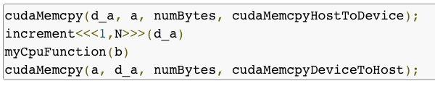
Default stream II
As soon as the increment() kernel is launched on the device, the CPU executes myCpuFuction with the kernel execution on the GPU.

Slide 68
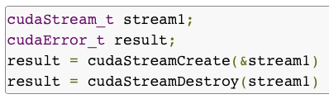

Non-default streams

Slide 69
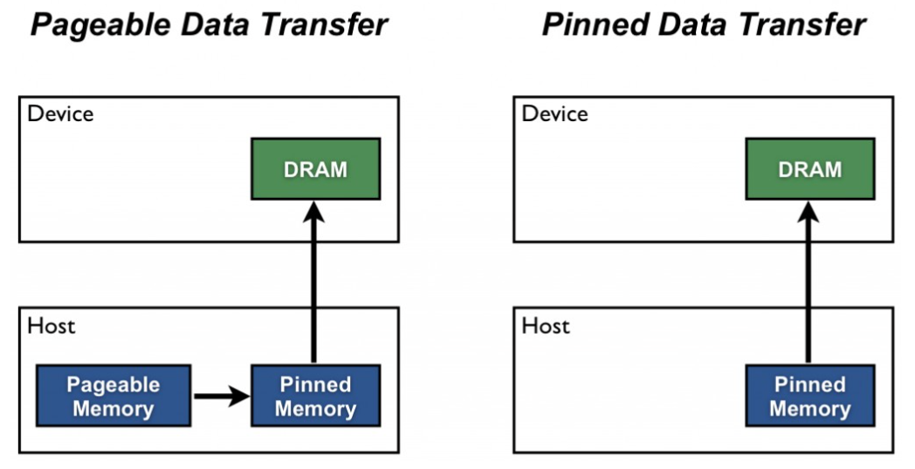
Pageable vs. Pinned

Slide 70
General guidelines of host-device data transfer
Minimize the amount of data transferred between host and device when possible, even if that means running kernels on the GPU that get little or no speed-up compared to running them on the host CPU.
Higher bandwidth is possible between the host and the device when using page-locked (or “pinned”) memory.
Batching many small transfers into one larger transfer performs much better because it eliminates most of the per-transfer overhead.
Data transfers between the host and device can sometimes be overlapped with kernel execution and other data transfers.

Slide 71
Overlapping Kernel Execution and Data Transfer
The device must be capable of “concurrent copy and execution”.
The kernel execution and the data transfer to be overlapped must occur in different, non-default streams.
The host memory involved in the data transfer must be pinned memory.

Slide 72
Examples
nvc++ default_stream.cu –o default_stream
nsys profile –o default_stream –stats=true ./default_stream
nvc++ multiple_streams.cu –o multiple_streams
nsys profile –o multiple_streams –stats=true ./multiple_streams

Slide 73
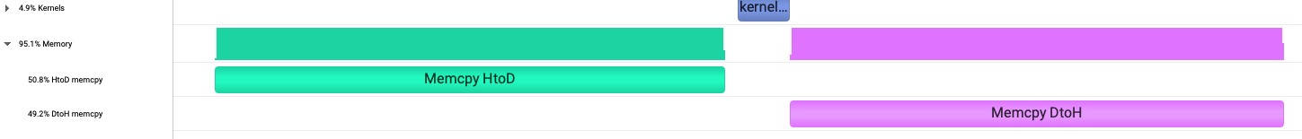
Overlapping computation and data copy
Default stream
multiple streams

Slide 74


Continuous vs discrete Fourier Transform
$$H\left(f\right)= \int_{−∞}^{∞}{h\left(t\right)e^{−j2πft}dt}$$
$$H= \sum_{k=0}^{N−1}{h\left(k\right)e^{−j2πnk/N}} n=0,1,…N−1$$

Slide 75


Fourier Transform of a rectangular pulse
$$h\left(t\right)=A \left|t\right|<T_{0}$$
$=0 \left|t\right|>T_{0}$
$$H\left(f\right)= \int_{−T_{0}}^{T_{0}}{Ae^{−j2πft}dt}$$
$$=A\int_{−T_{0}}^{T_{0}}{\cos\left(2πft\right)dt−jA\int_{−T_{0}}^{T_{0}}{\sin\left(2πft\right)dt=\frac{A}{2πf}\sin\left(2πft\right)|_{−T_{0}}^{T_{0}}}}$$
= $2AT_{0}\frac{sin(2πT_{0}f)}{2πT_{0}f}$

Slide 76
cuFFT, CUDA Fast Fourier Transform
Highly optimized for input sizes in the form 2ª×3^{b}×5^{c}×7^{d}. Powers of two are fastest.
An O(nlogn) algorithm for every input data size
Half-precision (16-bit floating point), single-precision (32-bit floating point) and double-precision (64-bit floating point). Transforms of lower precision have higher performance.
Types supported are:
  C2C - Complex input to complex output
  R2C - Real input to complex output
  C2R - Symmetric complex input to real output
1D, 2D and 3D transforms
Execution of multiple 1D, 2D and 3D transforms simultaneously.
In-place and out-of-place transforms
Arbitrary intra- and inter-dimension element strides (strided layout)
FFTW compatible data layout
Execution of transforms across multiple GPUs
Streamed execution, enabling asynchronous computation and data movement

Slide 77
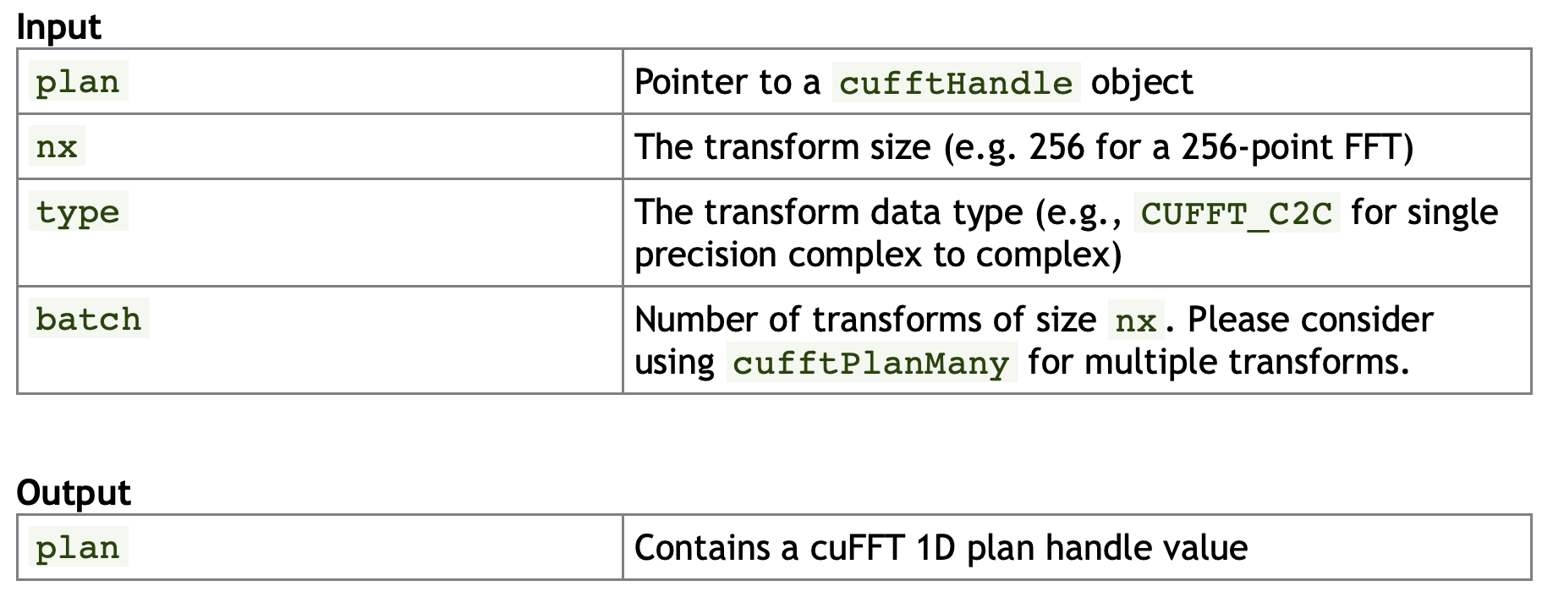
cufftPlan1d
https://docs.nvidia.com/cuda/cufft/index.html#cufft-api-reference

Slide 78
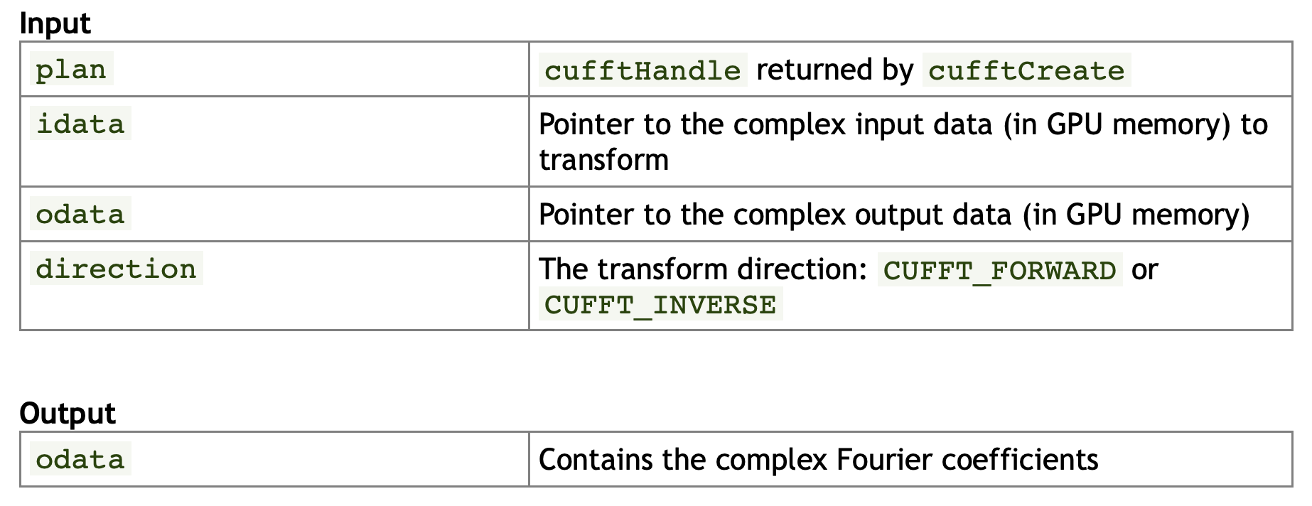
CUFFTExecC2C
https://docs.nvidia.com/cuda/cufft/index.html#plan-execution

Slide 79
fftw, cufft
gcc -std=c99 -I/usr/include -L/usr/lib64 -lfftw3f fftw_c2c_rect.c
nvcc -l cufft cufft_c2c_rect.cu
gnuplot
gnuplot> load “cufft_c2c_rect.plt”

Slide 80
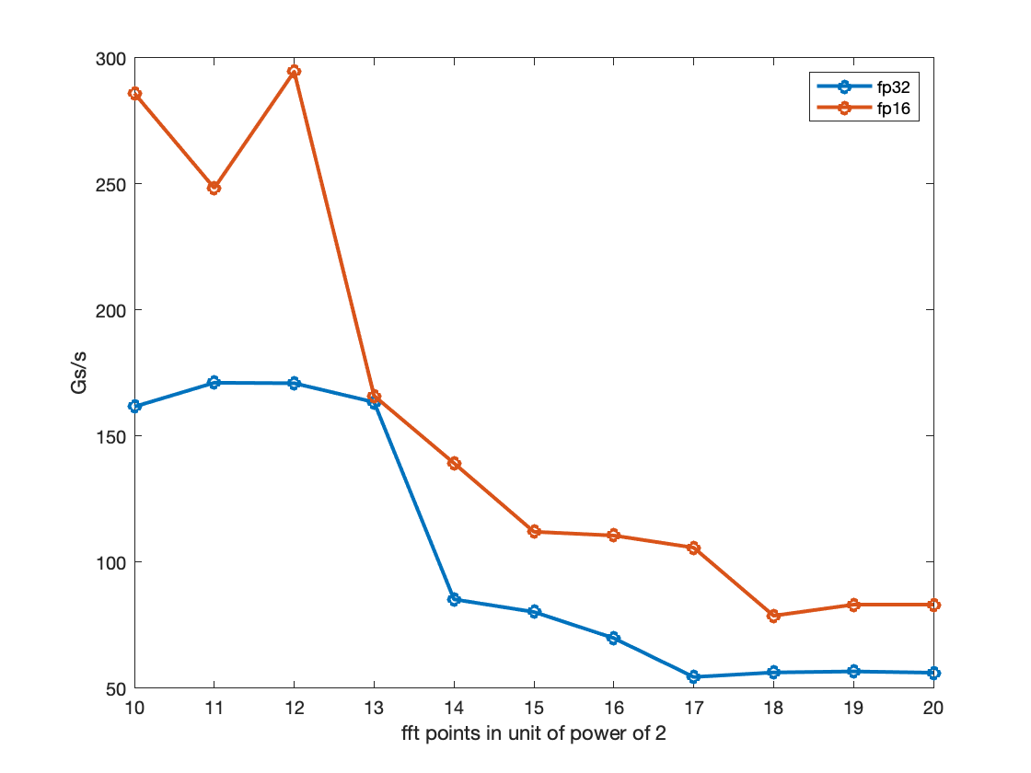
FFT performance of NVIDIA A100-PCIE-40GB
The single-precision (half-precision) FFT performance of NVIDIA A100 is 80 (112) Gsamples/s with 32768 FFT points.
Assuming the 80 Gs/s FFT performance of one GPU, we need about 100 GPUs to process FFTs of 8.2Ts/s.
112 Gs/s for fp16
80 Gs/s for fp32
NVIDIA A100-PCIE-40GB
1024
32768
1048576

